Slide 1

RefBank and ReFinder
ViBRANT’s reference management tools
ViBRANT
Virtual Biodiversity
Dauvit King, The Open University, UK, David.King@open.ac.uk
ViBRANT/BeBOL/JEMU workshop, RBINS, 11 June 2013

Slide 2
Introduction
RefBank
Why create another reference aggregator?
Scratchpads integration
How this is helpful to the researcher
ReFinder
Why create another reference finder?
PWT integration
How this is helpful to the researcher
6
Notes:
RefBank
ReFinder

Slide 3
RefBank
King et al. (2011) Towards the bibliography of life. In: Smith & Penev (Eds) e-Infrastructures for data publishing in biodiversity science. ZooKeys 150: 151–166.
Downloadable from: http://dx.doi.org/10.3897/zookeys.150.2167
6
Notes:
Goal in ViBRANT was to build a bibliography of life, not RefBank.
Overall process in ViBRANT was to re-use existing tools wherever possible.
Idea was to use CiteBank from BHL as wide audience and tied to primary source material; but that tool’s scope was changed to BHL articles only.
Looked for another existing biodiversity related reference tool: RefBank, from Plazi and developed by ViBRANT partner KIT.
Major deliverable in ViBRANT to take RefBank from targeted audience of Plazi to wider scope, adding much import and export functionality.
Cut to demo: http://vbrant.ipd.uka.de/RefBank/search
Show search screen
Do search, Penev 2012 - Show result handling options
Cut to Scratchpads sandbox: http://sandbox.scratchpads.eu/
Show add biblio
Do search, Penev 2012 - Show result handling options

Slide 4
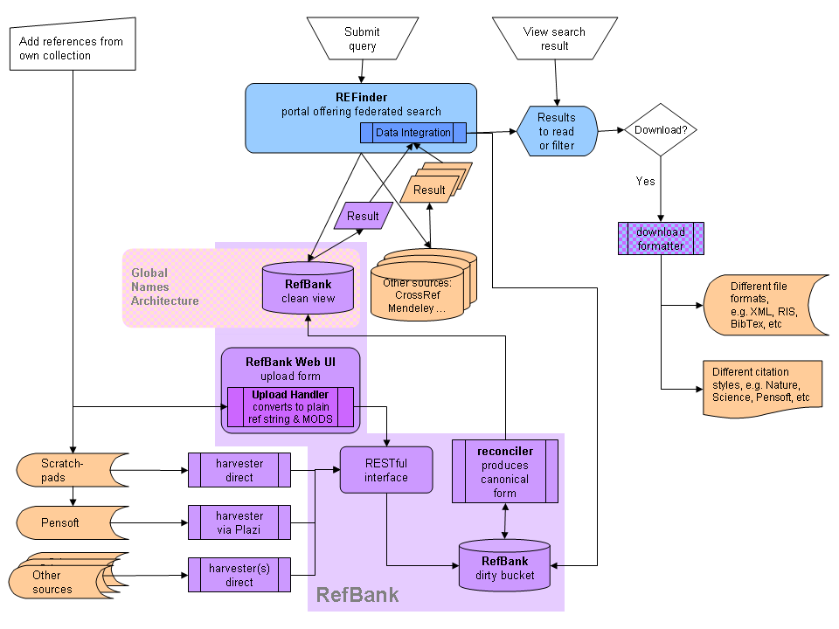
6
Notes:
ReFinder
Bibliography of life is a nice idea, but want to ensure it’s used; not yet another abandoned initiative.
ReFinder is part of the answer; extends integration of RefBank into daily workflow of the researcher.
Talk through slide with ReFinder as stand alone tool

Slide 5
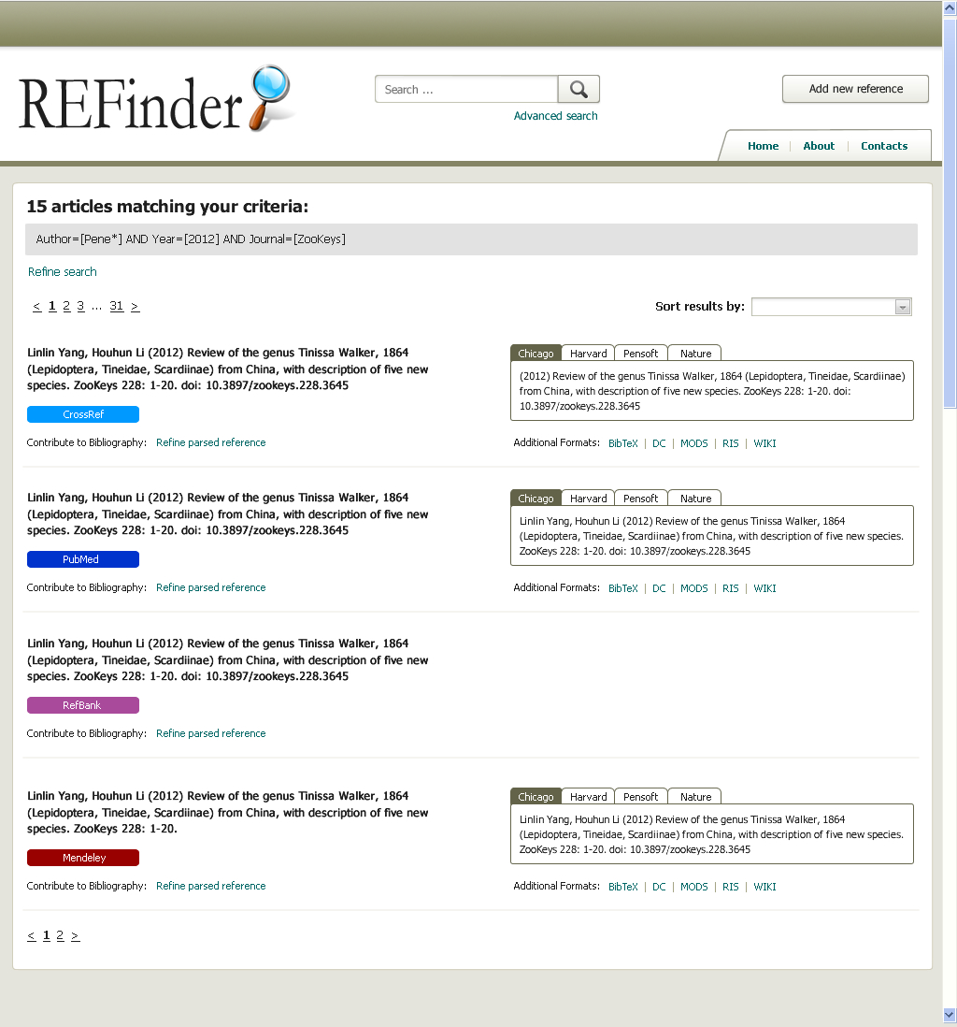
Notes:
Mock up of proposed search results screen based on simple search terms already available in RefBank.
Looking to offer faceted search, using additional keywords.
Key benefit is ‘Contribute to bibliography’ so easily add accurate citation to own writing.
Is no longer just a standalone tool is integrated into publishing workflow = PWT as presented by Lyubo earlier.

Slide 6
Conclusion
RefBank
Scratchpads integration
No additional work to share references
ReFinder
PWT integration
No additional work to use references
6
Notes:
RefBank
ReFinder

