Slide 1
Link yourself or perish? PhytoKeys, the next generation journal in systematic botany Lyubomir Penev¹, W. John Kress², Sandra Knapp³, De-Zhu Li⁴, Susanne Renner⁵ 1 Pensoft Publishers, Sofia, Bulgaria; 2 Smithsonian Institution, Washington DC, USA; 3 Natural History Museum London, UK; 4 Kunming Institute of Botany, Chinese Academy of Sciences, Heilongtan, Kunming, China; 5 University of Munich (LMU), Germany
International Botanical Congress IBC2011 Melbourne, ^{23-30 July 2011}
ViBRANT

Slide 2
Why new journal?
A new publishing model - Open Access
Electronic publications take the lead over paper
Electronic registers, indexes, aggregators (GBIF, EOL, IPNI, etc.) summarize information on biological taxa
Web 2.0 assumes semantic enhancements to published texts
Dissemination becomes at least so important as the act of publishing
Data publishing is to emerge as mandatory policy soon!

Slide 3
How PhytoKeys differs?
The first mandatory open access journal in systematic botany
The first to mandatory include IPNI records in the original description (protologue)
The first to imply domain specific XML schema (TaxPub) for semantic markup
All new taxa and treatments are exported to Encyclopedia of Life
All new taxa and treatments are exported to Wiki (Species-Id)
Data publishing with the GBIF and Dryad Data Repository

Slide 4
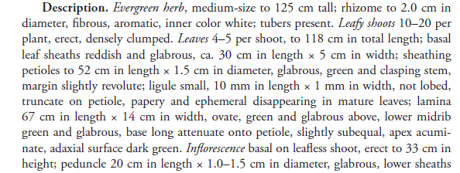
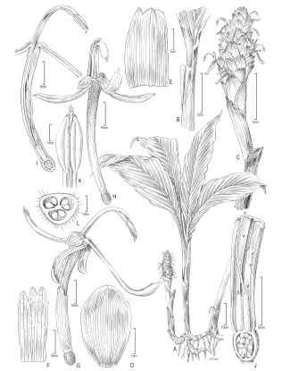
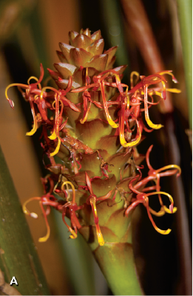
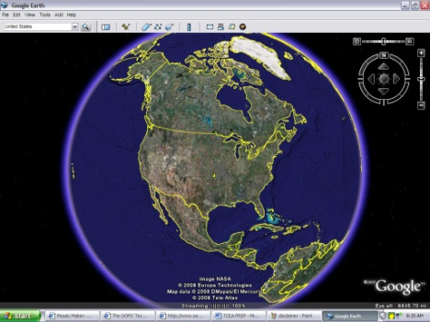
Why new technologies? Isn’t the PDF good enough?
Names
Literature
Descriptions
Plazi
Images
Occurrences

Slide 5
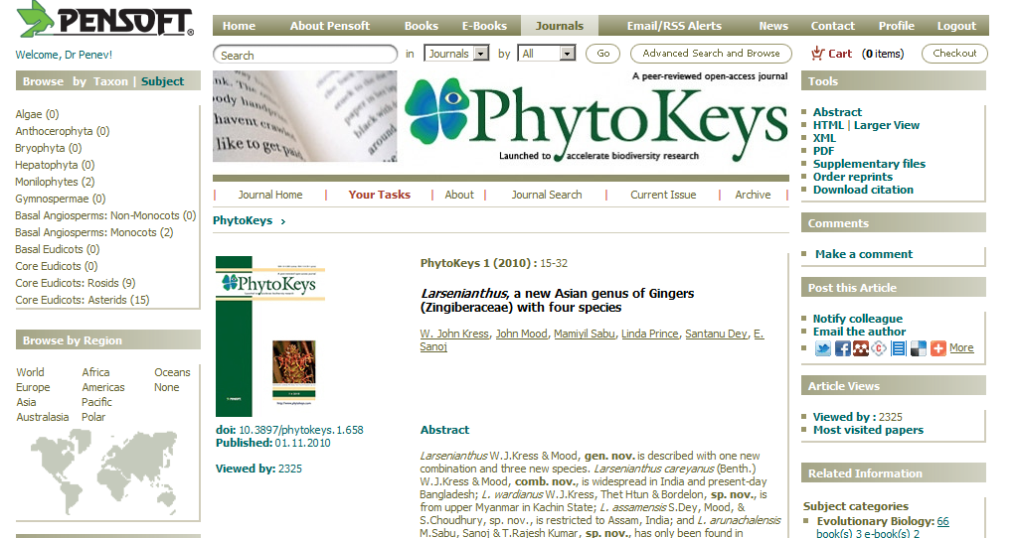
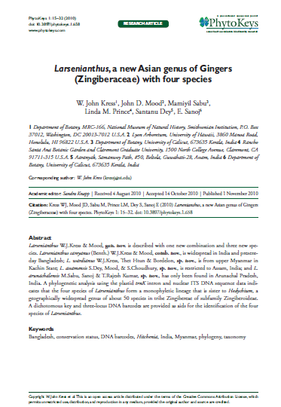
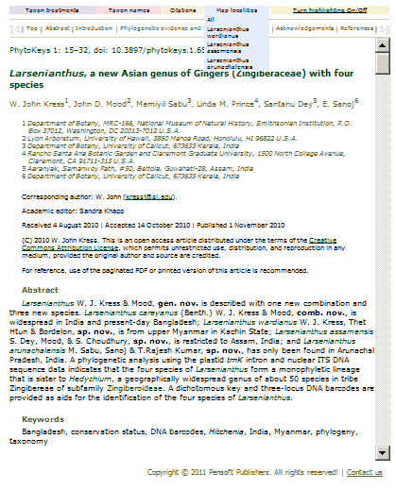
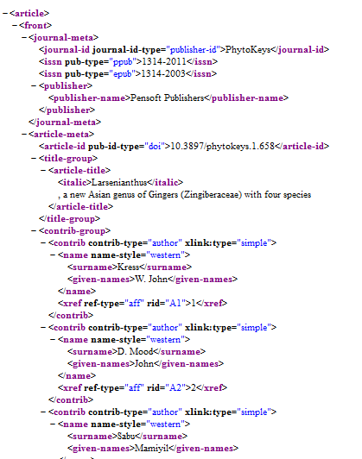
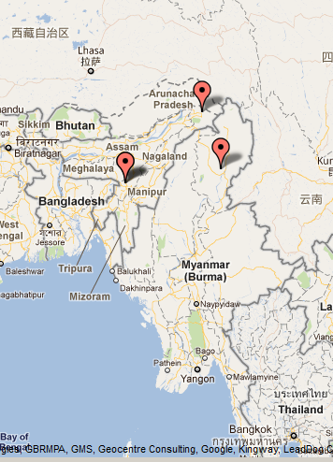
Why more e-versions of the same paper?

Slide 6
Why XML is so important?
Plazi

Slide 7
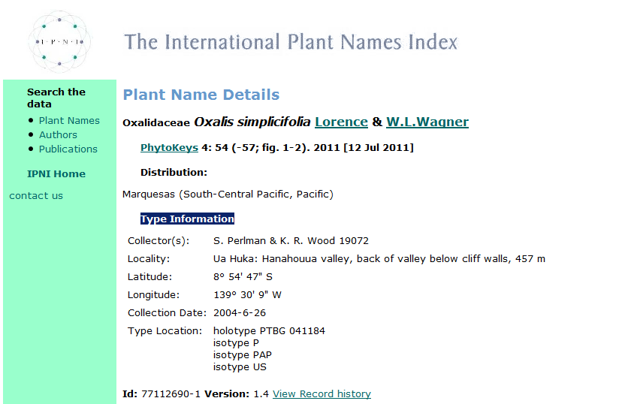
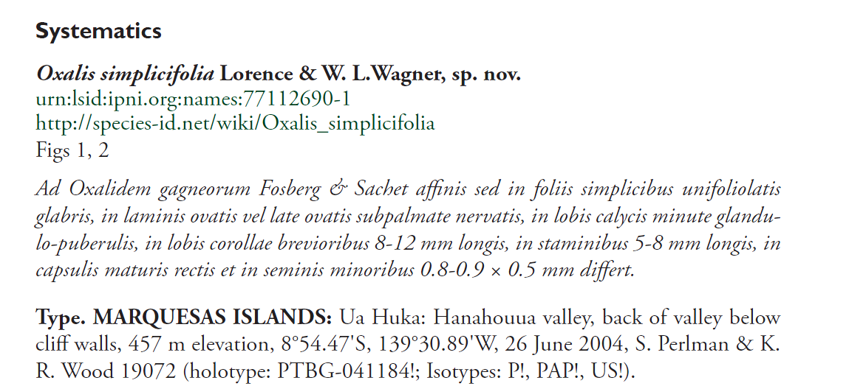
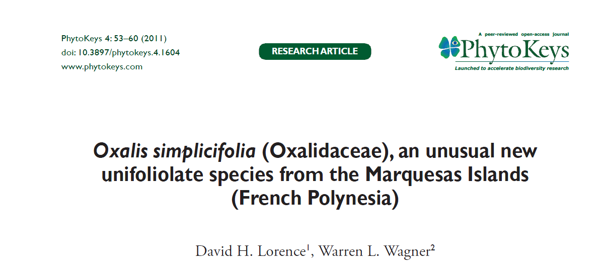
Mandatory registration with IPNI and inclusion of the IPNI record number in the protologue

Slide 8
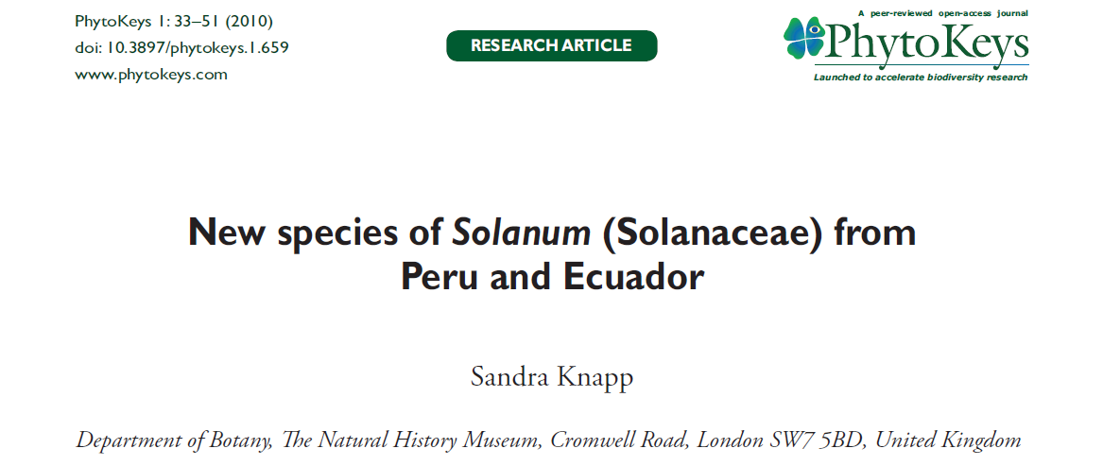
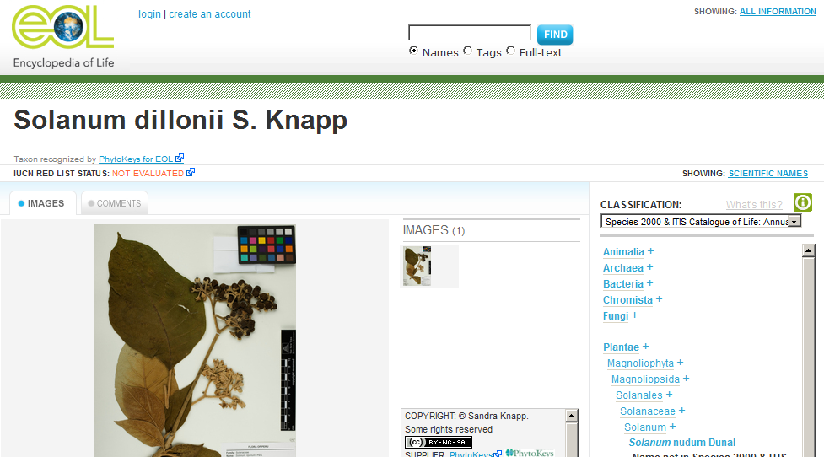
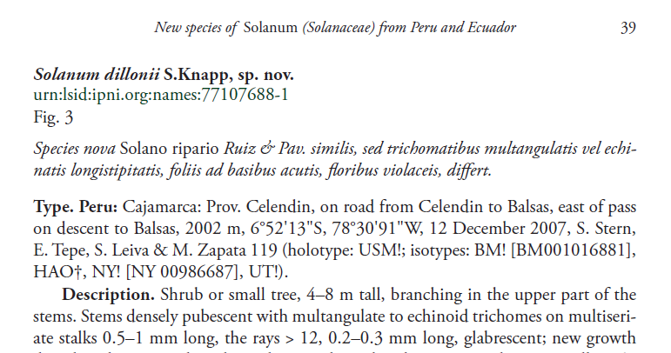
Automated export of species descriptions to Encyclopedia of Life (EOL)
XML MARK UP

Slide 9
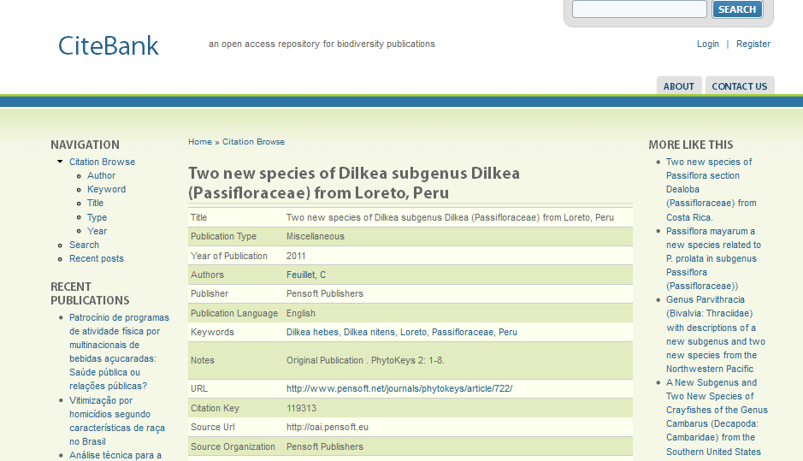
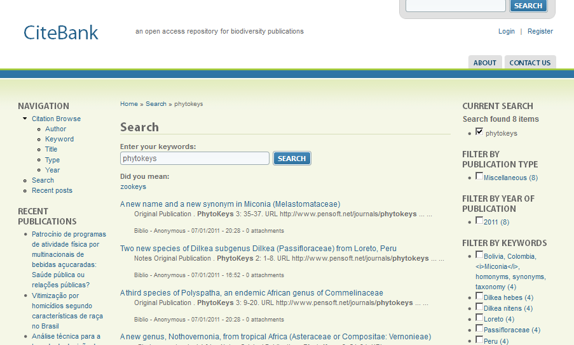
PhytoKeys on BHL CiteBank

Slide 10
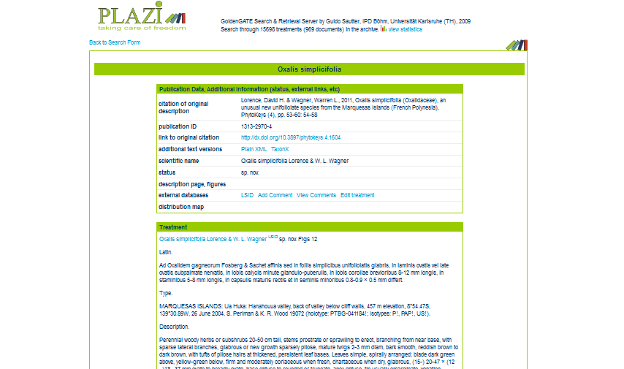
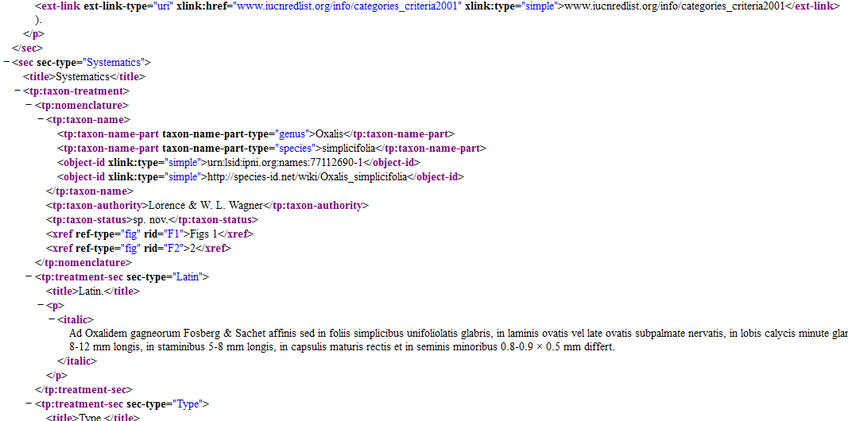
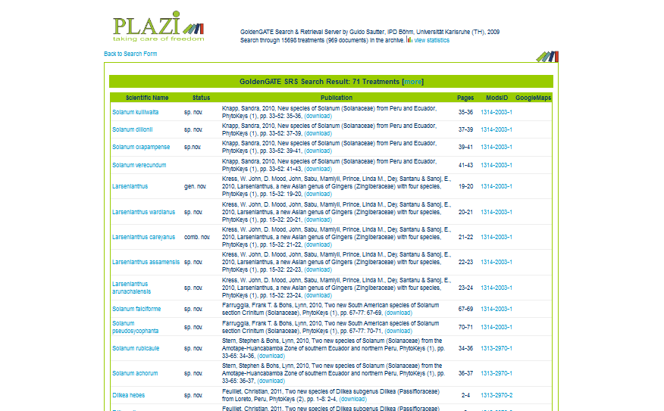
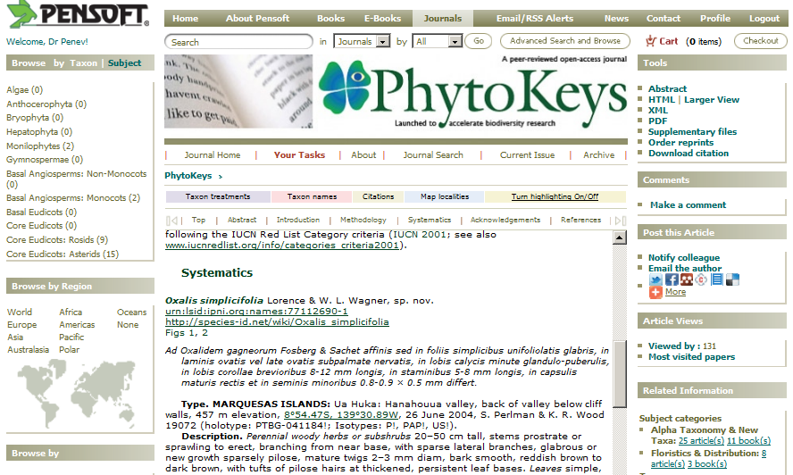
Automated harvesting and deposition of taxon treatments in Plazi.org

Slide 11
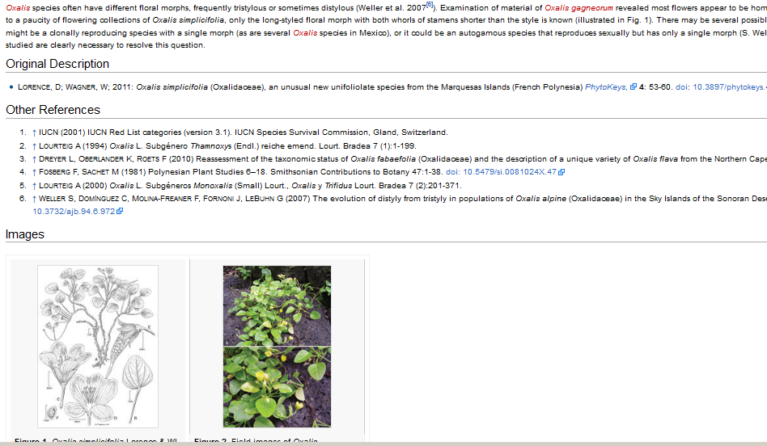
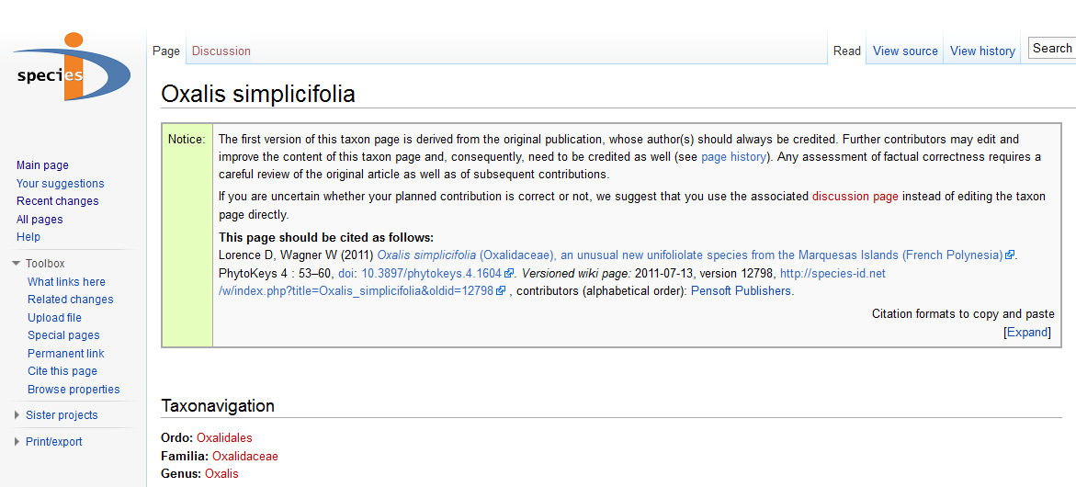
Export of treatments to Wiki and combined journal/wiki citation

Slide 12
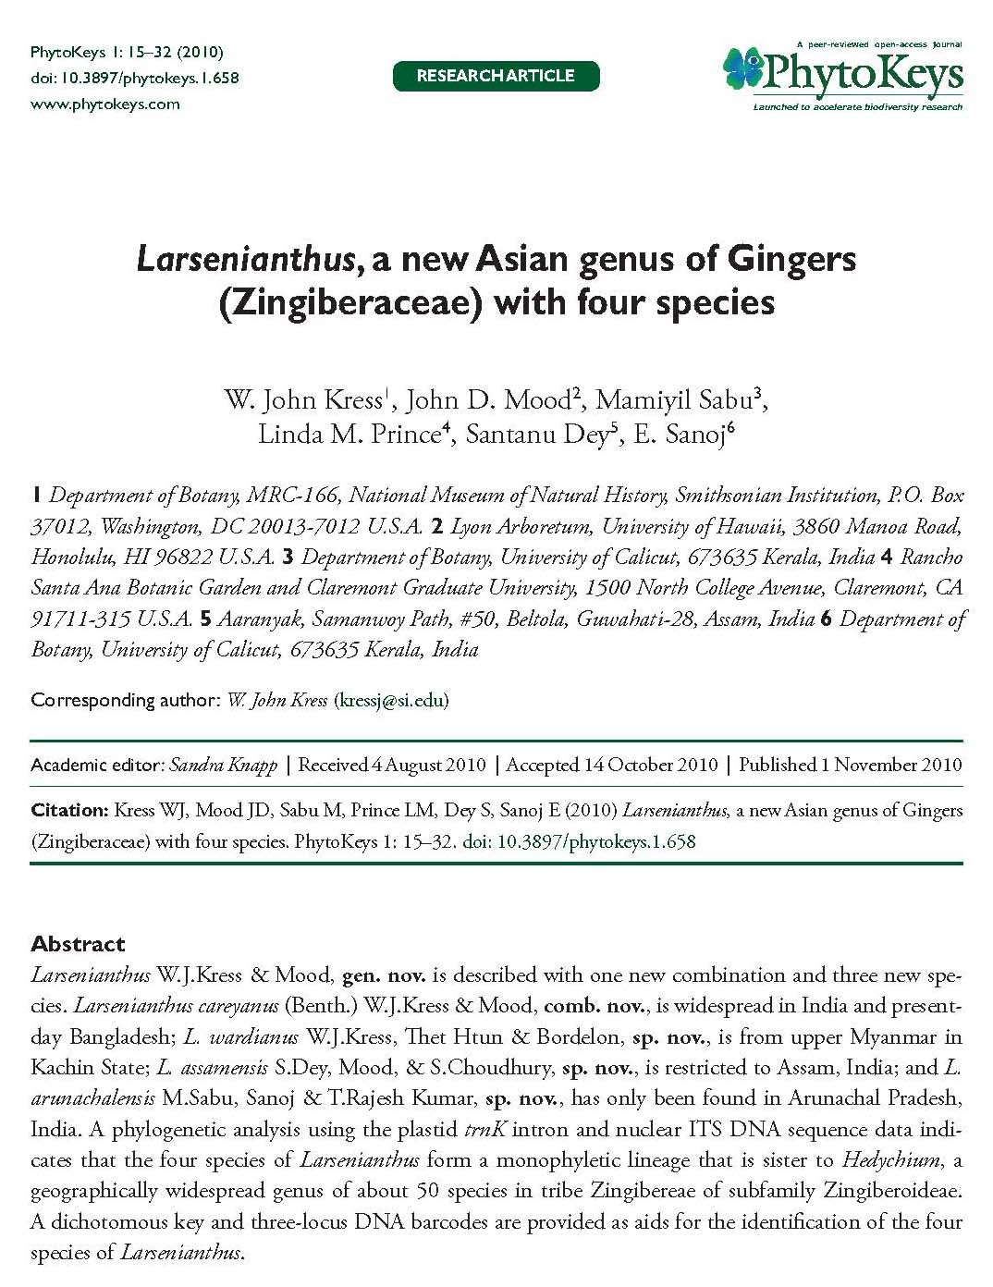
What semantic markup gives to the reader more than then PDF does?
Automated harvesting and deposition of taxon treatments in Plazi.org

Slide 13
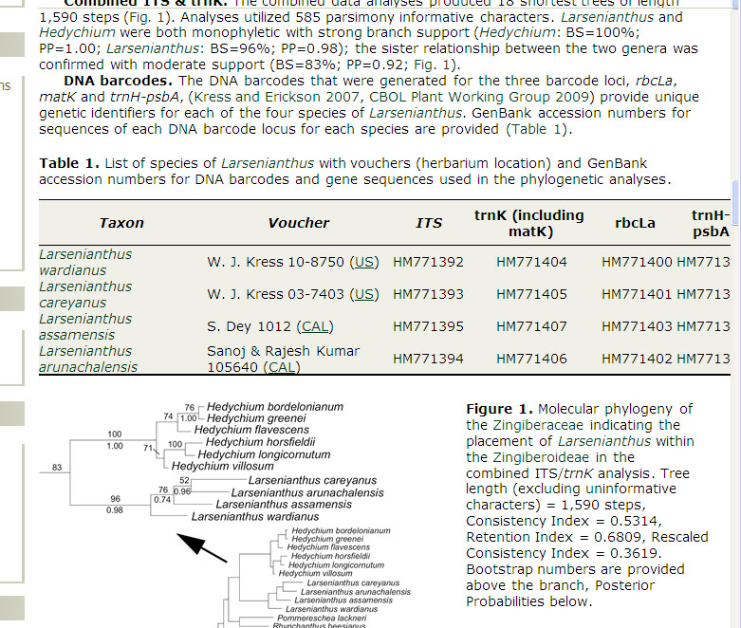
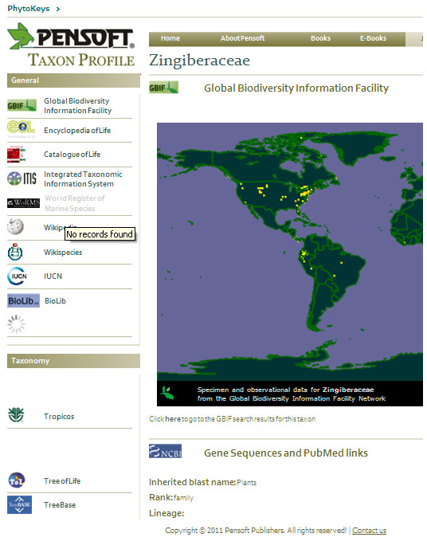
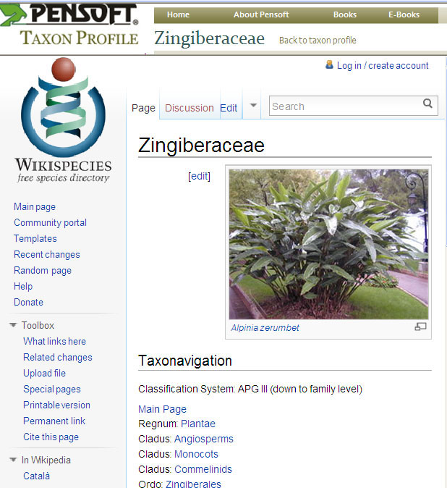
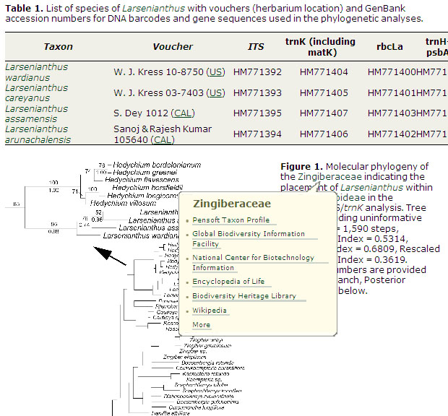

Slide 14
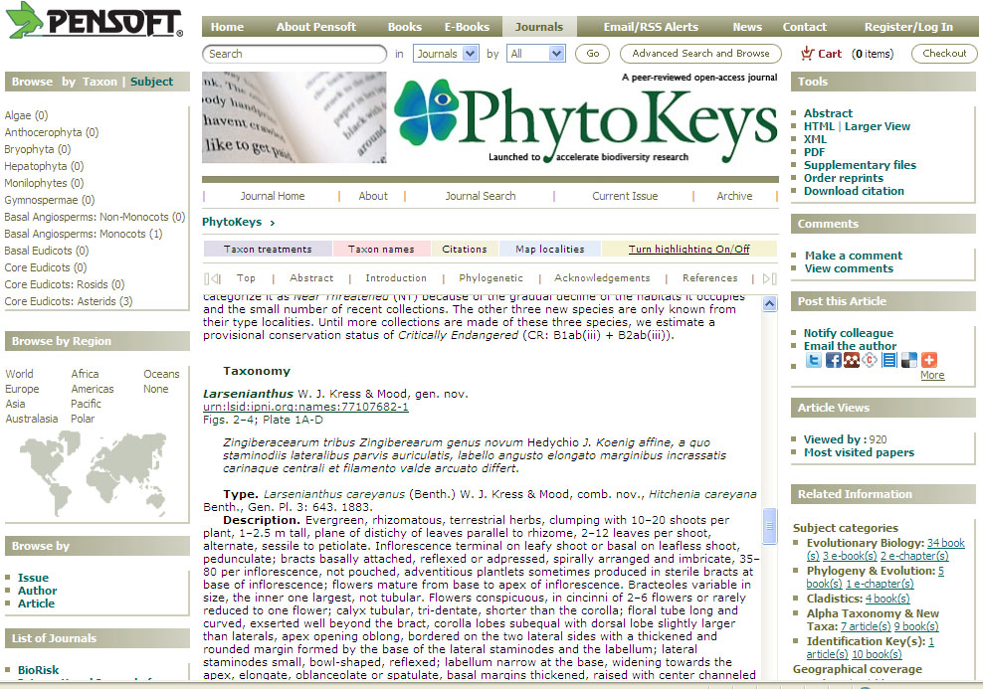
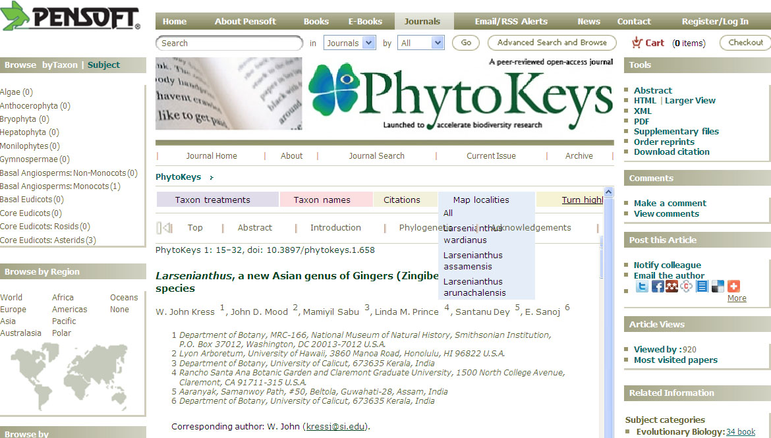
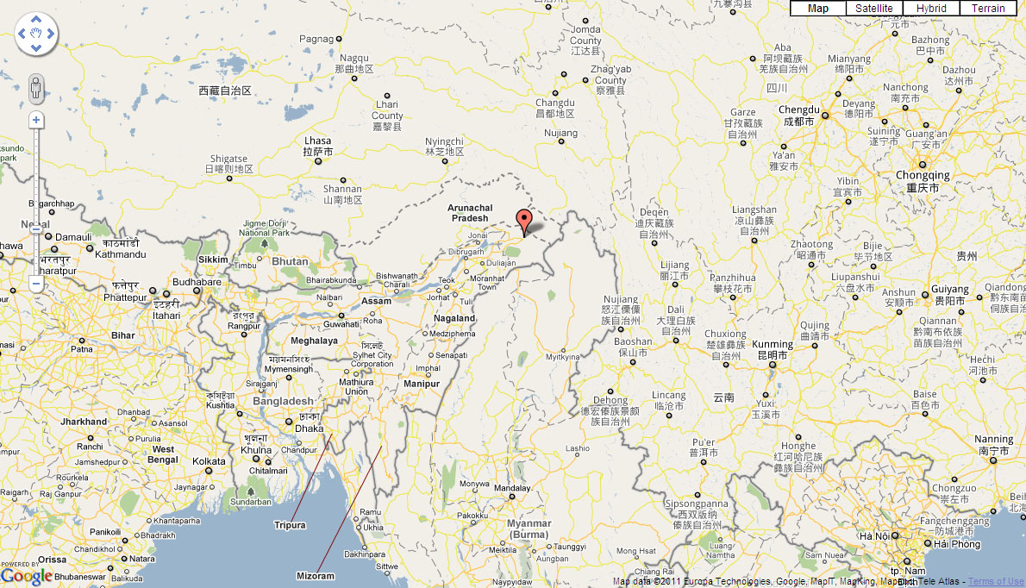

Slide 15
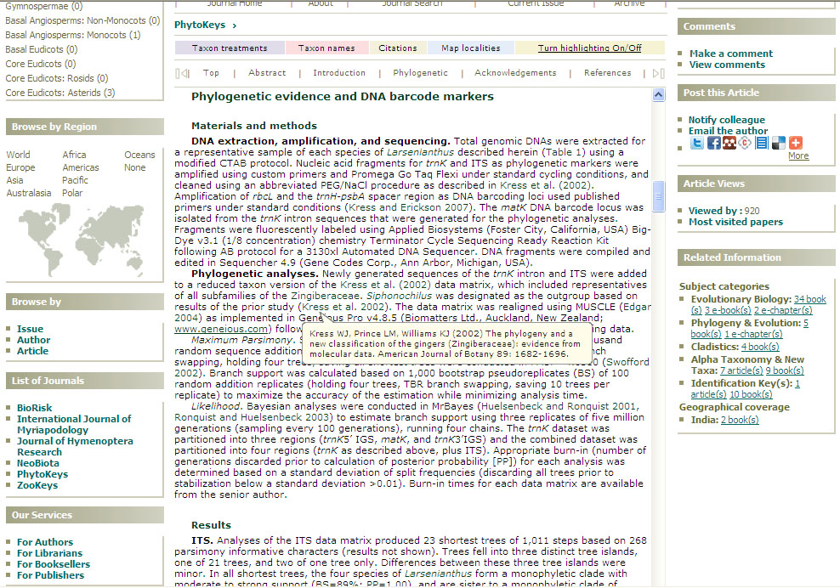
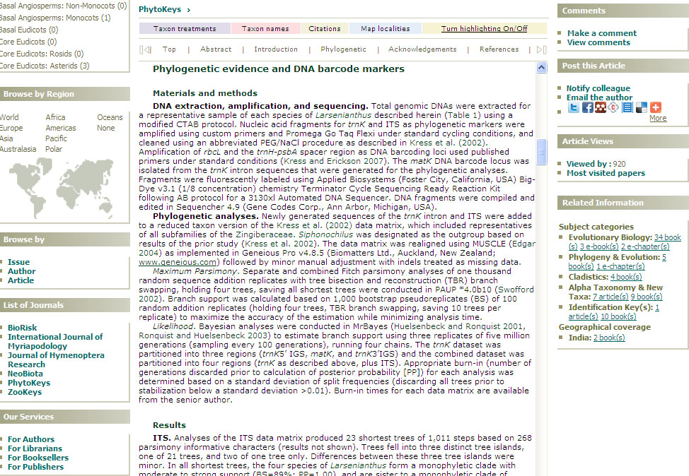

Slide 16
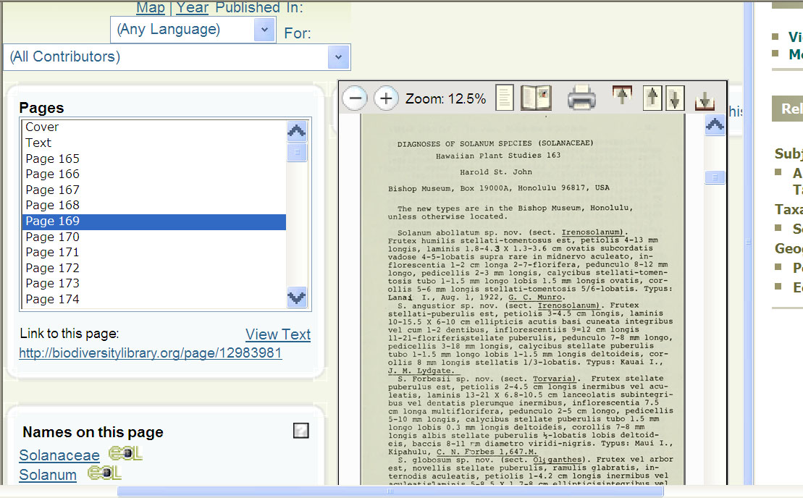
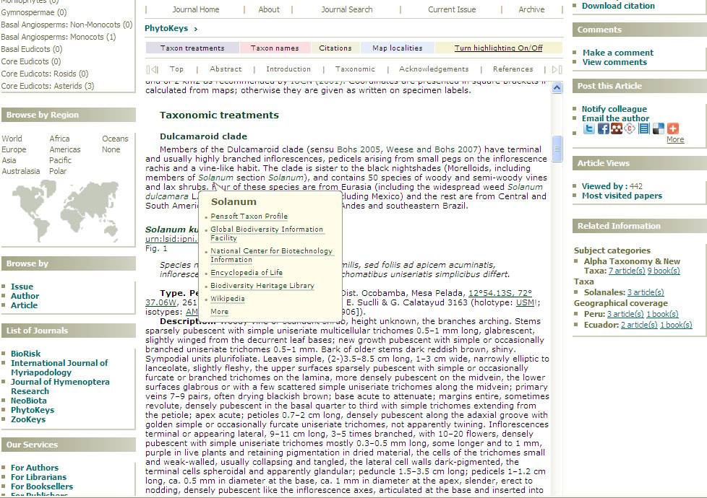
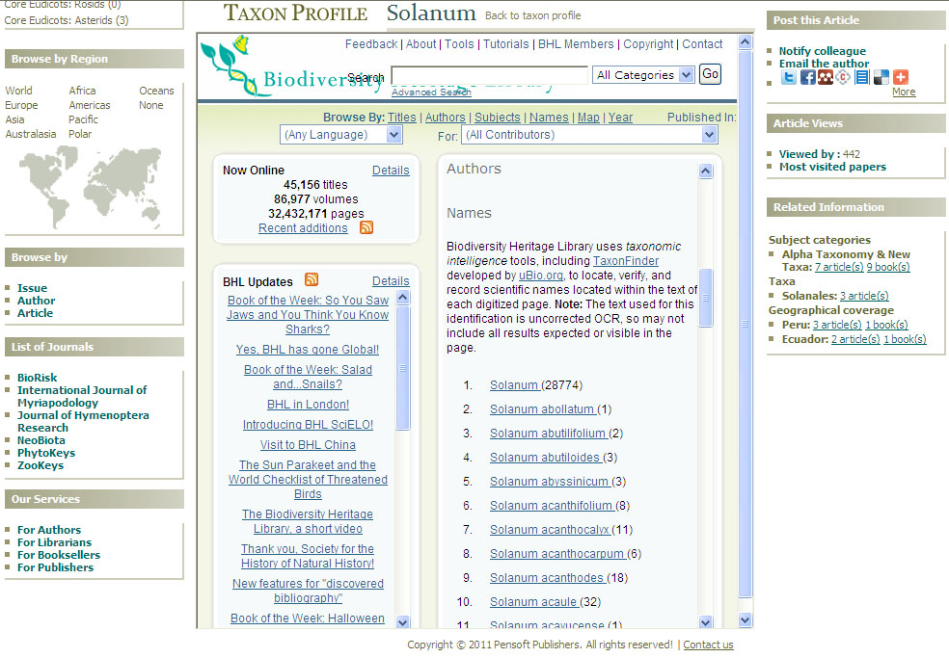
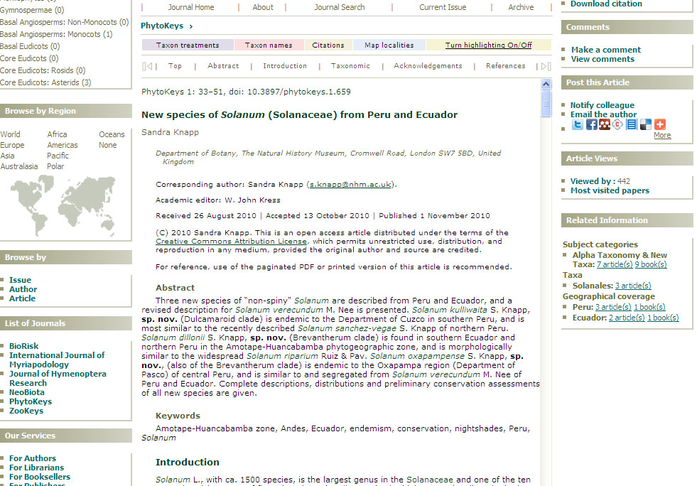

Slide 17
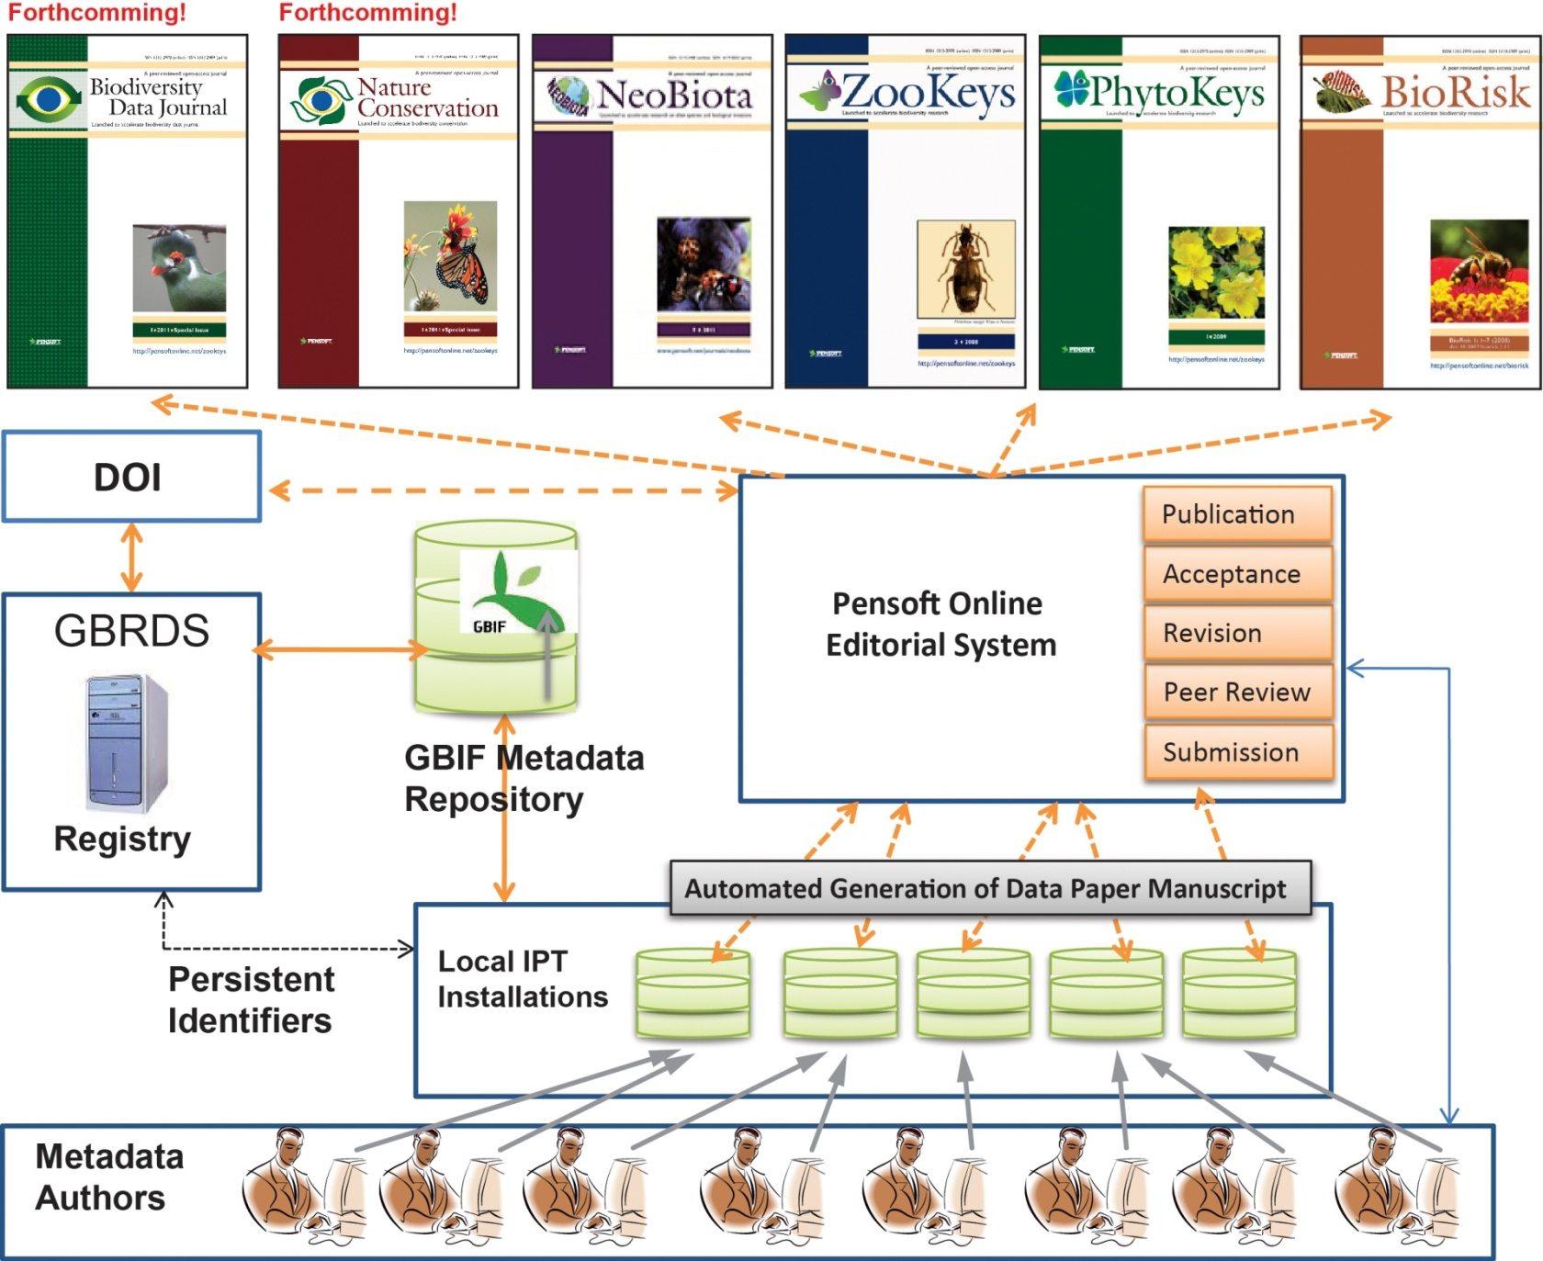
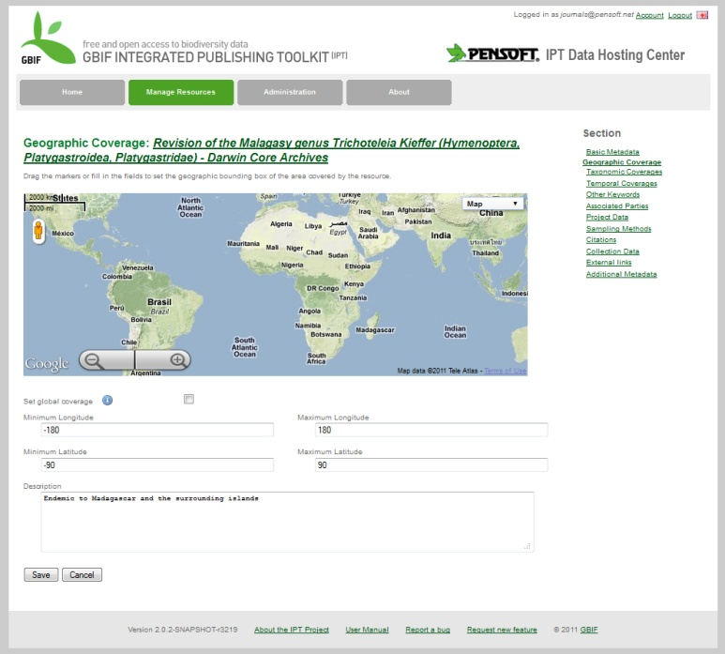
The occurrence dataset in GBIF
IPT

Slide 18
The near Future
ViBRANT
Virtual Biodiversity
Virtual Biodiversity Research and Access Network for Taxonomy" (ViBRANT) is a European Union FP7 funded project starting in December 2010 that will support the development of virtual research communities involved in biodiversity science. Our goal is to provide a more integrated and effective framework for those managing biodiversity data on the Web.

Slide 19
ViBRANT will provide
An automated, “press-a-button” submission of manuscripts, keys included, through XML, from Scratchpads, EDIT and authors’ databases
An automated, “press-a-button” submission of data paper manuscripts, through XML, from the GBIF metdata catalogue – data publishing!
Automated tools for dissemination of contents to EOOL, GBIF, Wiki environment and others
Launching of an open access, “next generation”, Biodiversity Data Journal
Unification of mark up standards and output for legacy literature and prospective publishing

Slide 20
XML-based publication and dissemination work flow
bn
GBIF-generated manuscripts from metadata descriptions
Scratchpads-
generated manuscripts
Manuscripts generated via customized online form
Manuscripts generated from
authors’ databases
Upfront pre-submission marked up manuscripts
Marked up final publication in PDF, HTML and XML formats
PENSOFT MARK UP TOOL (PMT)
Non-tagged manuscripts
(MS Word, Open Office)
Peer-review, editorial and publication process
Automated dissemination, archiving, indexing, harvesting
ARTICLES
Occurrence data
Taxon treatments
Taxon names
Plazi
Wiki
COL
BHL

Slide 21
All this is not easy, but......
... it is exciting ...
.... however it is possible only through Open Access!
“ Semi-automatically generated semantic, enhanced e-publications are the only way to describe the missing 10 M species, and to deal with an increasing flood of data.” Donat Agosti

Slide 22
I Open Access!
Thank you for your attention!

