Slide 1


Resolving the publishing bottleneck and increasing data interoperability in biodiversity science
Lyubomir Penev, Teodor Georgiev, Pavel Stoev, David Roberts, Vincent Smith
SEH 2013 - 17th European Congress of Herpetology, 22-27 August 2013, Veszprém, Hungary
ViBRANT

Slide 2
Comparable to the “taxonomic impediment”, but is caused by:
“Publishing Bottleneck in Biodiversity”
WHAT IS THAT?
increasing amount of data due to the intensification of scientific exploration;
publishing in non-machine-readable formats, e.g. paper/PDF;
low uptake and inconsistent policies for data publishing;
pressure of administrators to publish in “high-impact” journals;
increasing difficulties with peer-review.

Slide 3
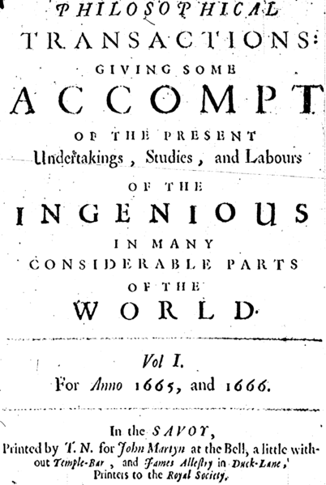
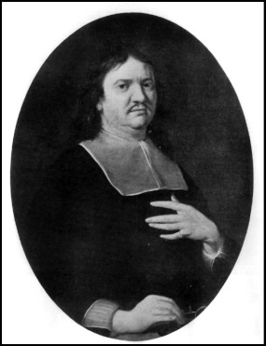
Source: Wikipedia

Slide 4
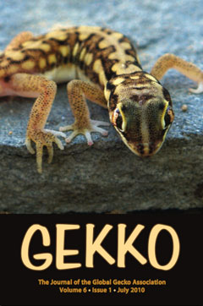
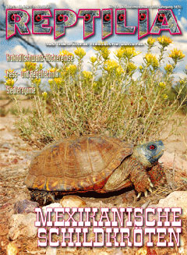

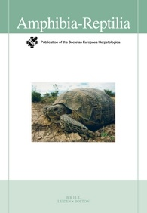

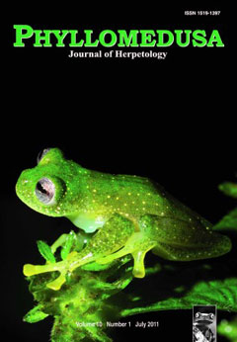
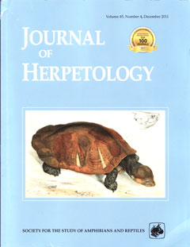
Estimated ca 1.8 Mio articles per annum, not counting the grey literature!

Slide 5
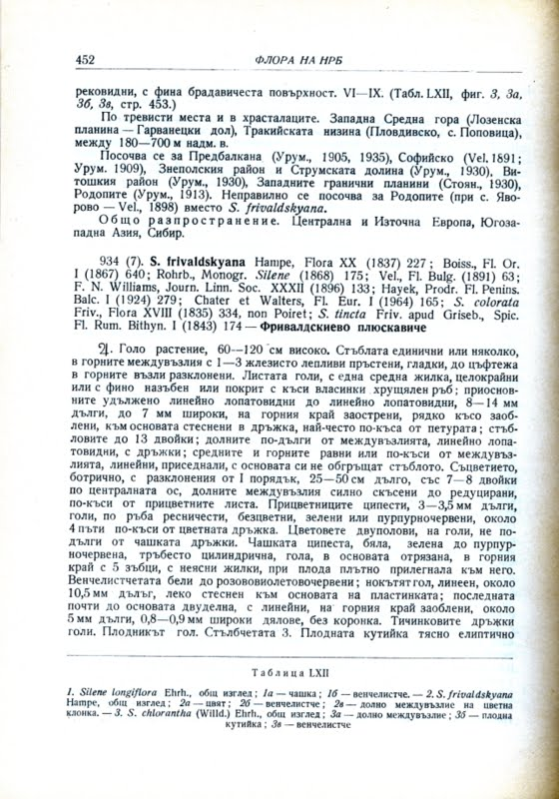
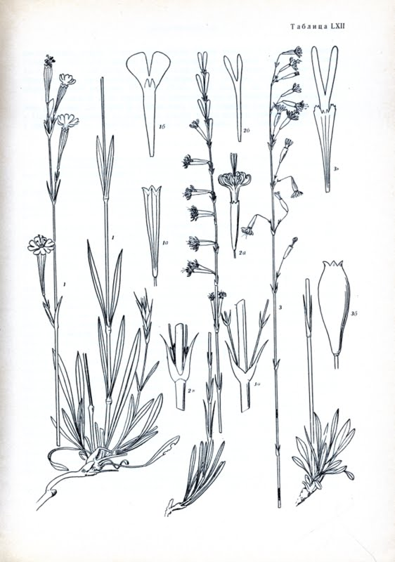
… and some hundreds millions pages of biodiversity literature in various languages

Slide 6

Low uptake of data opening and sharing

Slide 7
Incentives to publish data…
open data increases transparency and the overall quality of science
published data can be verified by other researchers
it can be integrated with other datasets
it increases the potential for interdisciplinary research
duplication of data-collecting efforts and associated costs will be reduced
published data can be indexed and made discoverable
Notes:
7
There are several incentives for authors and institutions to publish data:
There is a widespread conviction that data produced using public funds should be regarded as a common good, and should be openly published and made available for inspection, interpretation and re-use by third parties.
Open data increases transparency and the overall quality of science; published datasets can be re-analyzed and verified by others;
Published data can be cited and re-used in the future, either alone or in association with other data;
Open data can be integrated with other datasets across both space and time;

Slide 8
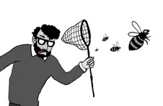
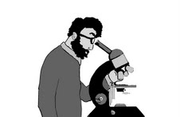

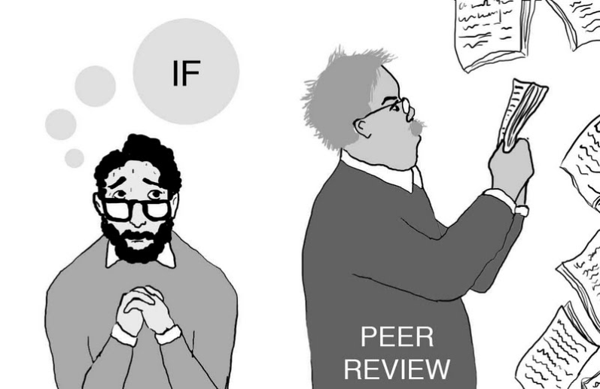
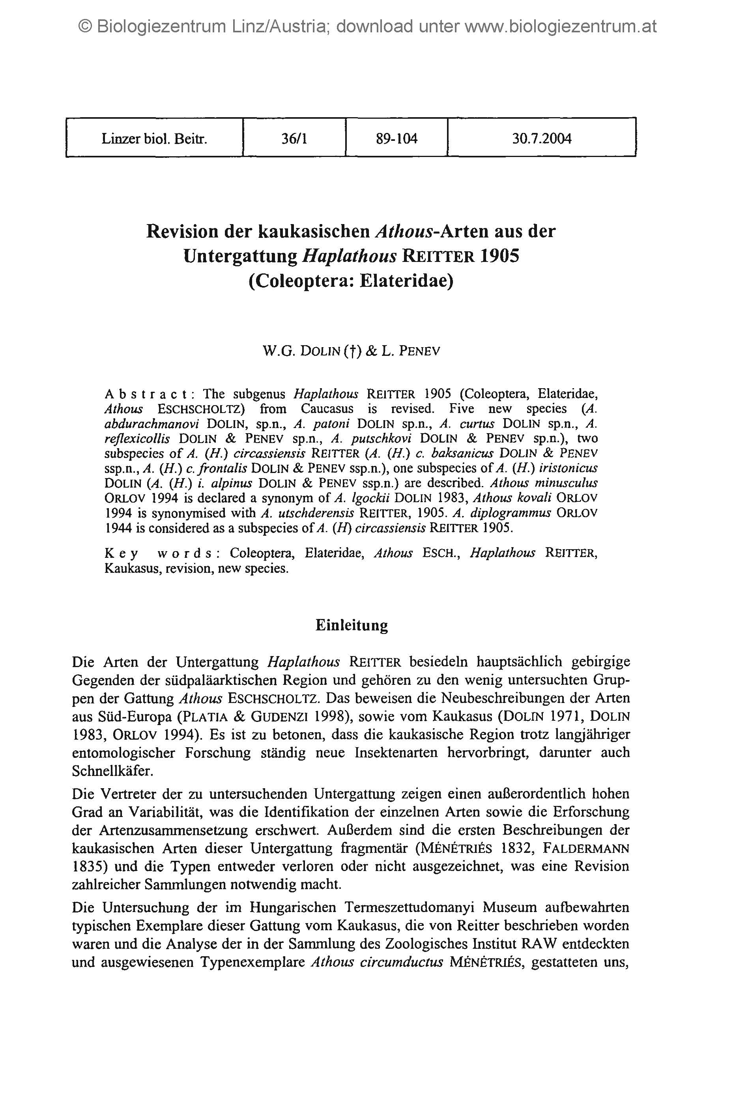




Drawings: slavenapeneva.com
Primary data

Slide 9
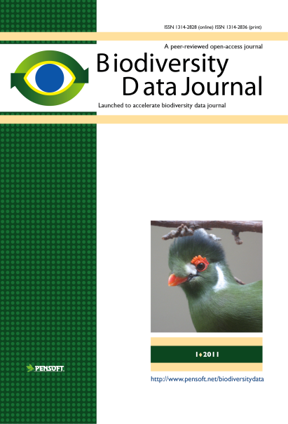
RE-USE
of
CONTENT
Publishing and sharing of primary data
Primary data

Slide 10
Notes:
10
Slide 12: Next generation article publishing
Arguably our most ambitious developments in the context of scholarly communication concern the semi-automated construction of scholarly papers from databases. In many cases Scratchpads contain extensive data relating to the biology and description of particular species. These are highly suited to formal specialist publications, but doing so require the laborious assembly of these data into a manuscript. As part of the ViBRANT collaboration with Pensoft, and in particular their two journals specialising in the formal taxonomic descriptions of plants and animals, we have developed a 5-step workflow for users to selecting appropriate data from their Scratchpad, adding additional metadata describing this information so that it conforms with the norms of descriptive taxonomic publications, and then finally preview and submit this manuscript to the publisher. From here is goes through a standard peer review process. Review recommendations are then incorporated in to a revised version of the manuscript, which is then sent back to the publisher and simultaneously published on both the Scratchpad and in the publisher’s journal.
In addition to dramatically speeding up the construction of scientific papers, the user has the advantage that firstly the manuscript can be revised and updated and new information comes to light on the Scratchpad, while preserving the original version of the manuscript as part of the scholarly record. In addition the publish extracts relevant information from the submitted database which is them automatically submitted to the specialist data repositories.
So in sum then, these are the four ways in which ViBRANT is facilitation scholarly communication of biodiversity information. 1) Through low cost journal infrastructure; 2) by community web publishing; 3) by biodiversity observation data publishing; and 4) by next generation publishing services producing scholarly articles from databases.

Slide 11

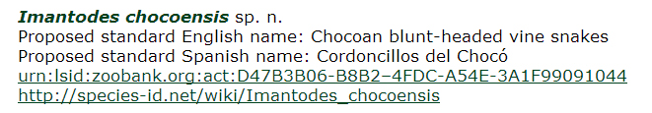

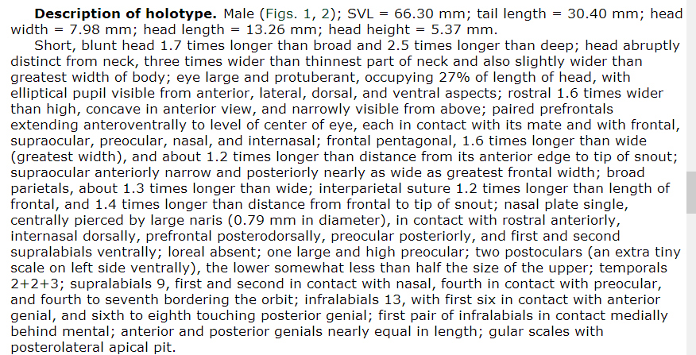



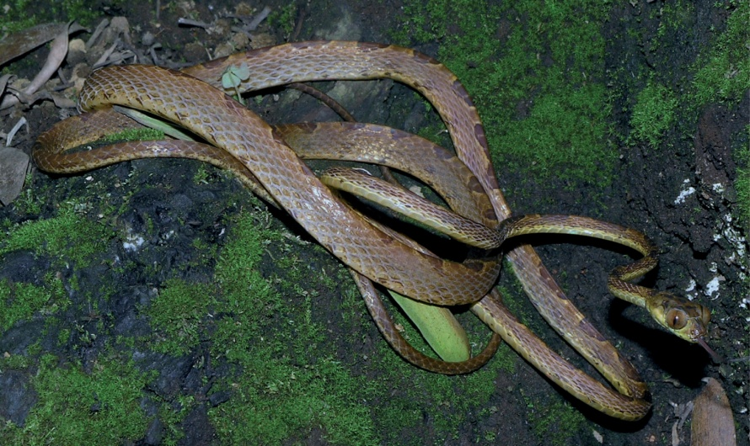

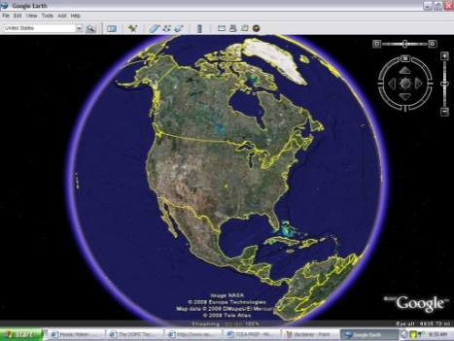

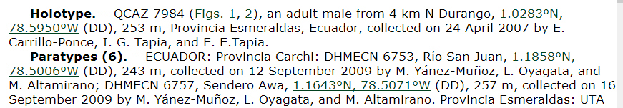
Integration of data published in the BDJ
Nomenclature
Literature
Descriptions
Plazi
Images
Occurrences

Slide 12
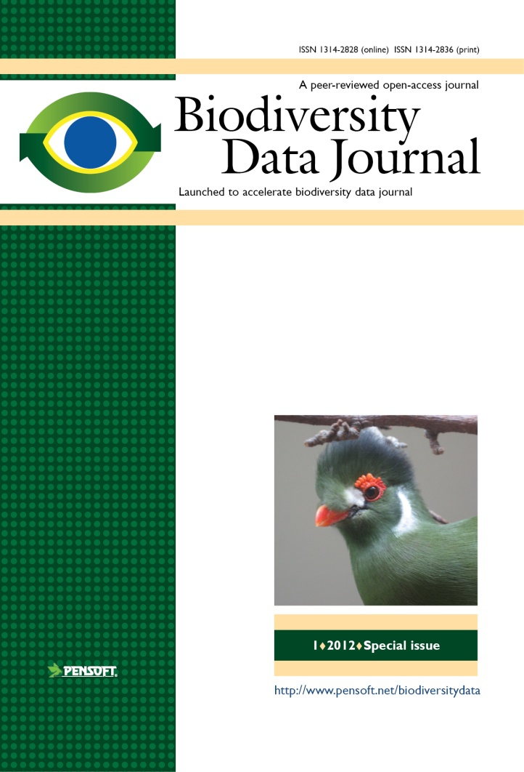
BDJ is different from ALL other journals
Collaborative online article authoring, peer-review and editing
Community peer review; options for “open” and “public” review
Standard-compliant (Darwin Core)
ICNafp and ICZN compliant article templates
No lower/upper limit of manuscript size
Semantically enhanced “articles
of the future”
Integrated with GBIF, EOL, Dryad Scratchpads, etc.
ALL DATA MATTERS!

Slide 13
What will BDJ publish?
Single taxon treatments and nomenclatural acts
Local or regional checklists
Sampling reports and occasional inventories
Habitat-based checklists and inventories
Ecological and biological observations
Single identification keys
Biodiversity-related databases, including genomic, ecological and environmental data (data papers)
Biodiversity-related software tools
Notes:
The BDJ will publish a variety of articles and data including:
Single taxon treatments and nomenclatural acts – accretional taxonomic work
Local, regional and
habitat-based checklists
and sampling reports
Interesting or novel ecological and biological observations
Single free-standing identification keys
Any kind of biodiversity-related databases and datasets
Biodiversity software tools and use cases

Slide 14
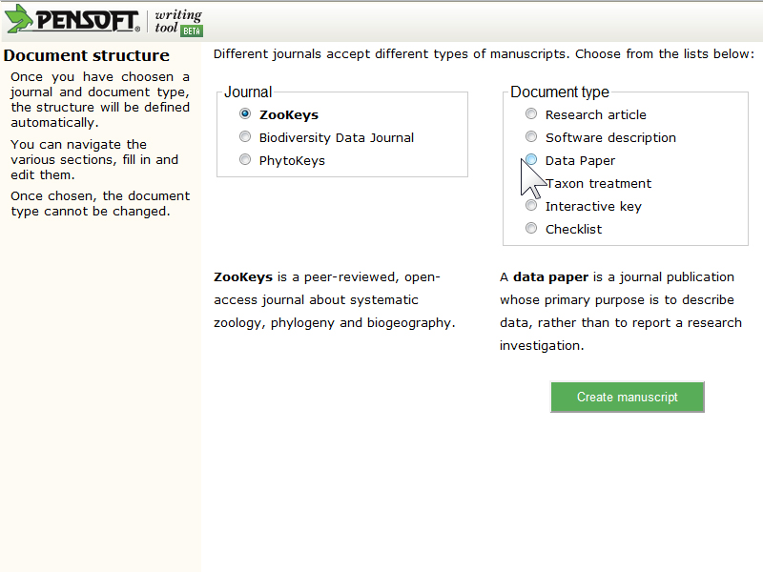
Choose article template

Slide 15
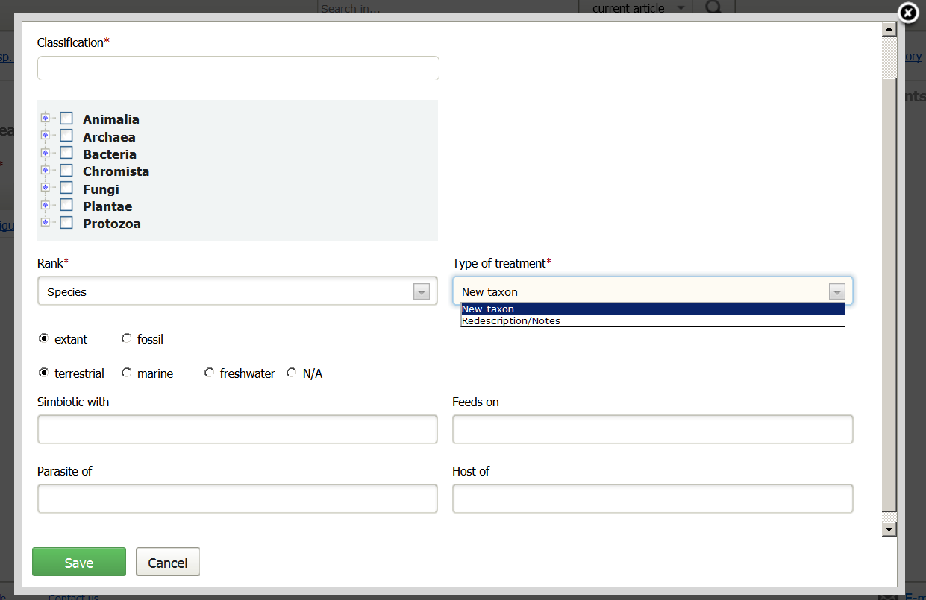

Slide 16
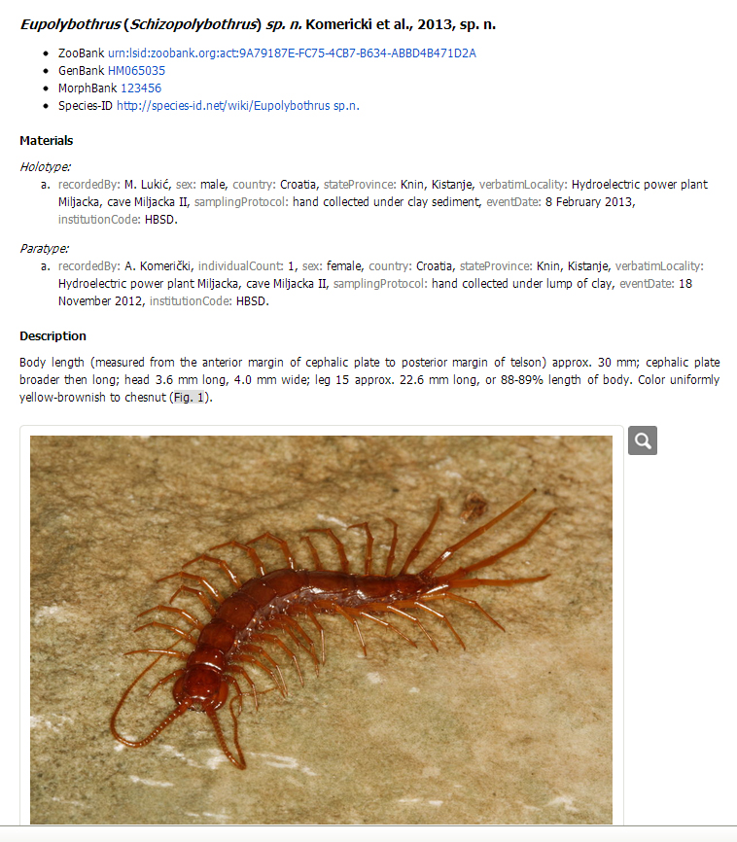
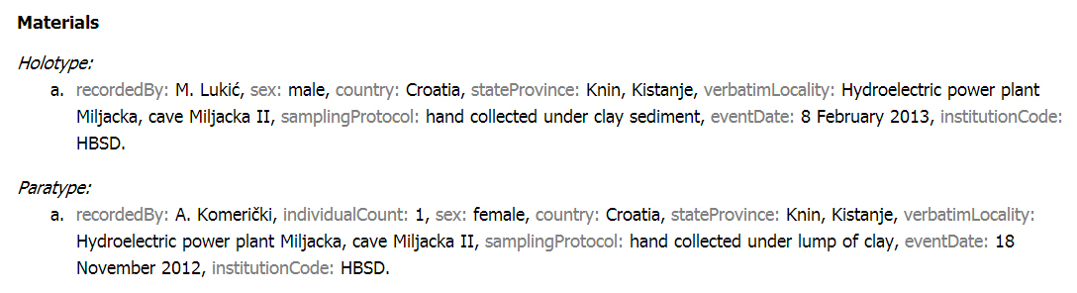
Taxon treatment: new species

Slide 17
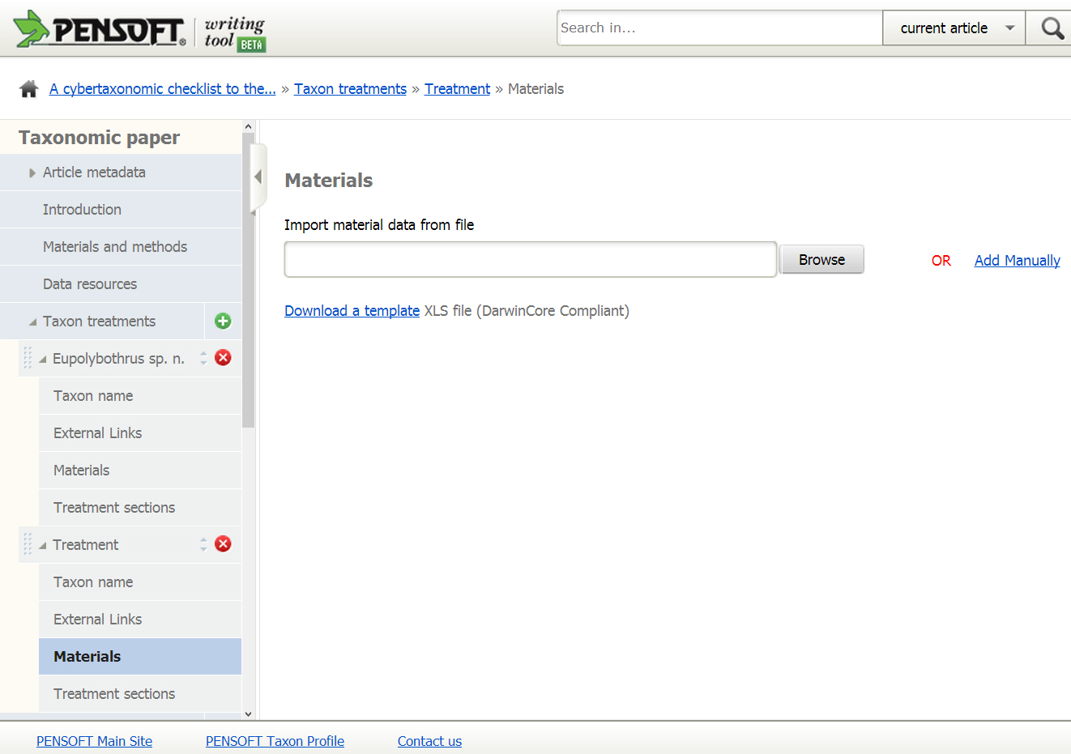
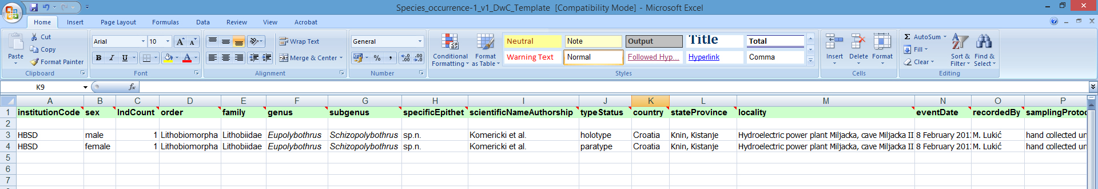
Taxon treatment: import material data

Slide 18
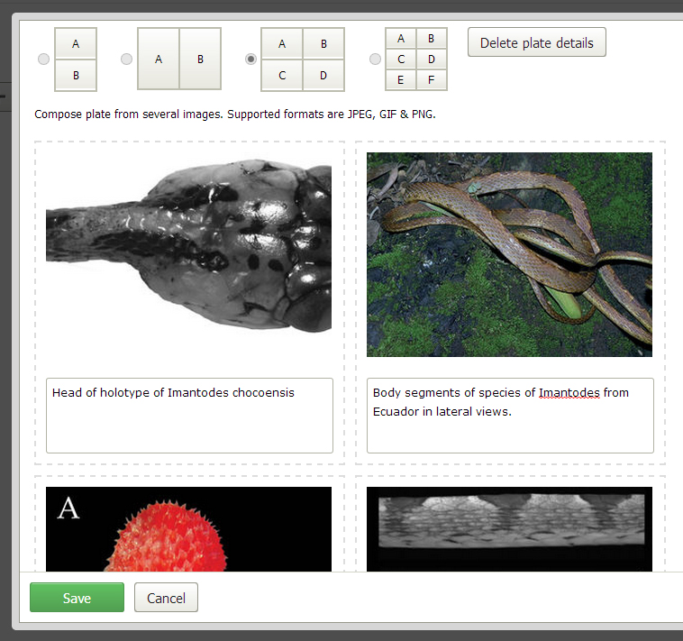
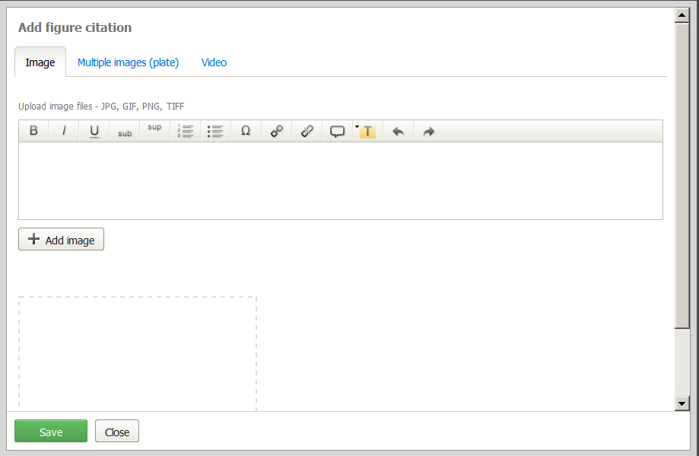
Taxon treatment: upload of images

Slide 19
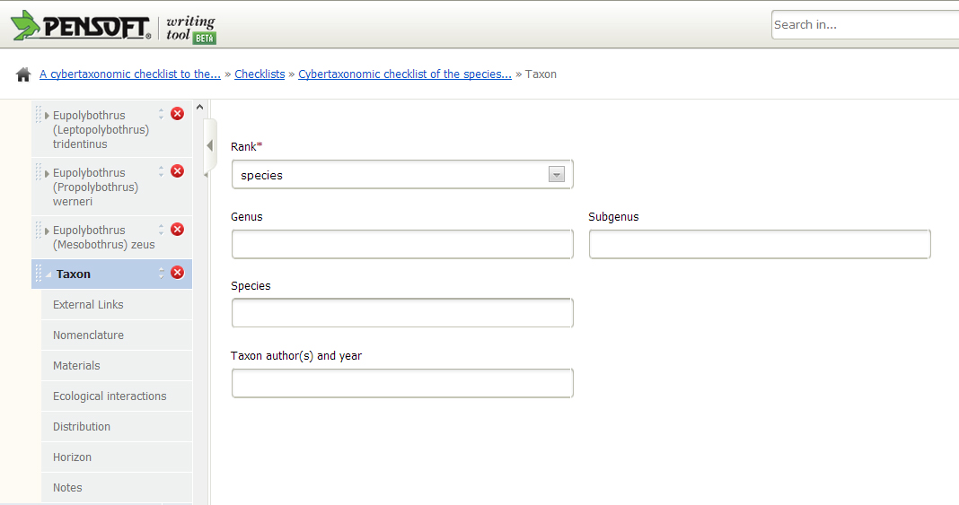
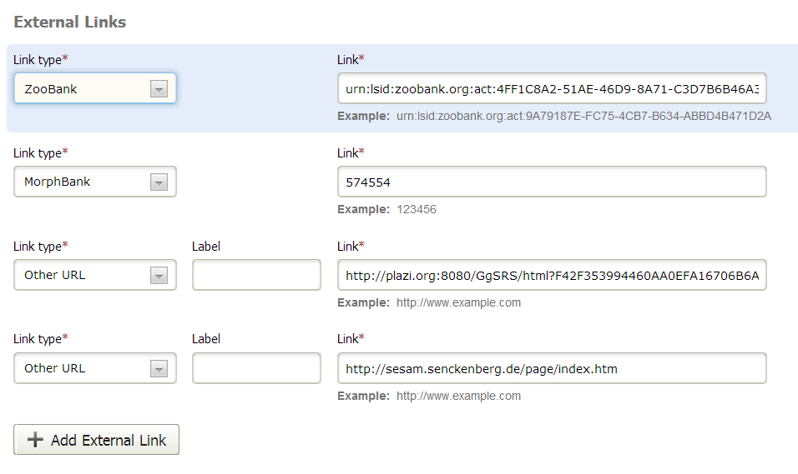
Structure of the checklist filed

Slide 20
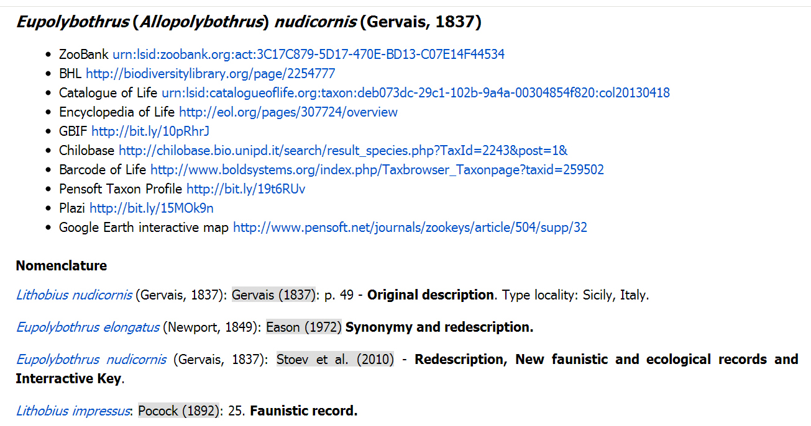
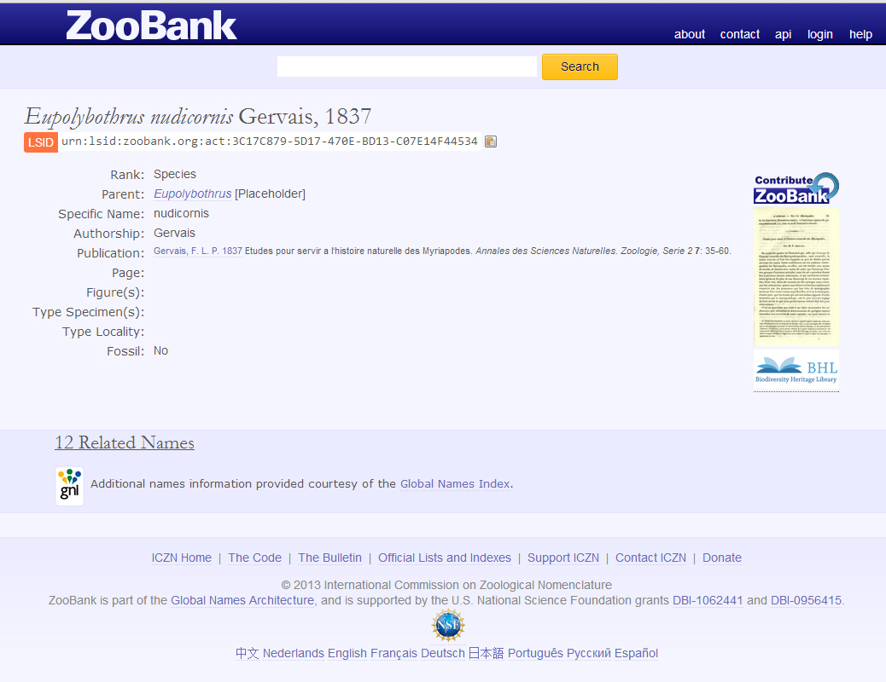
External links

Slide 21
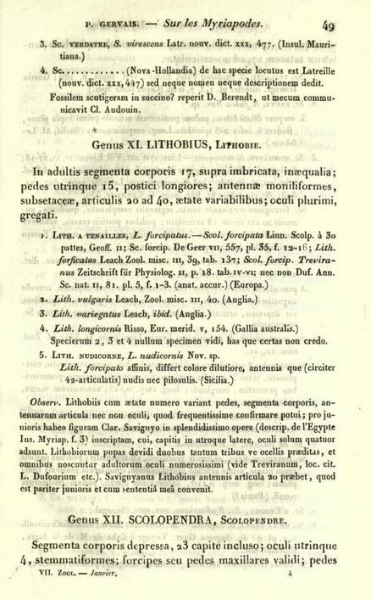
External links

Slide 22
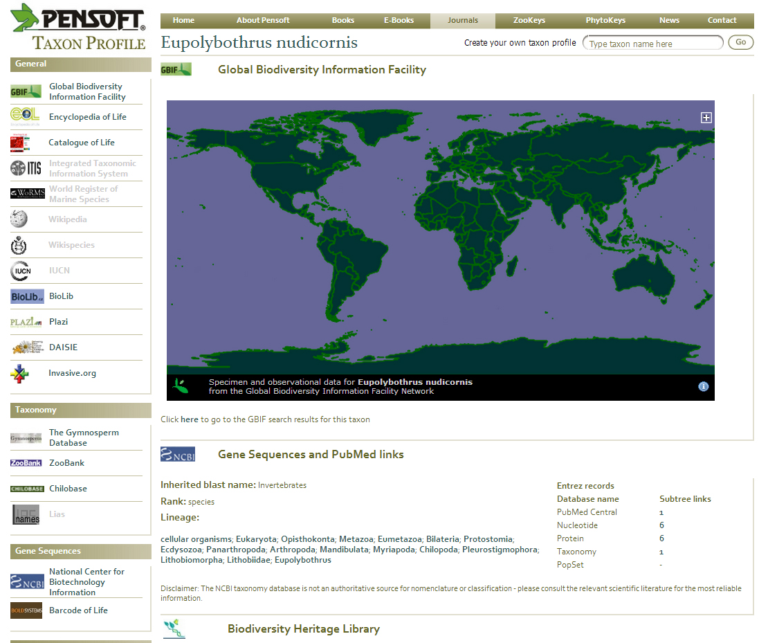
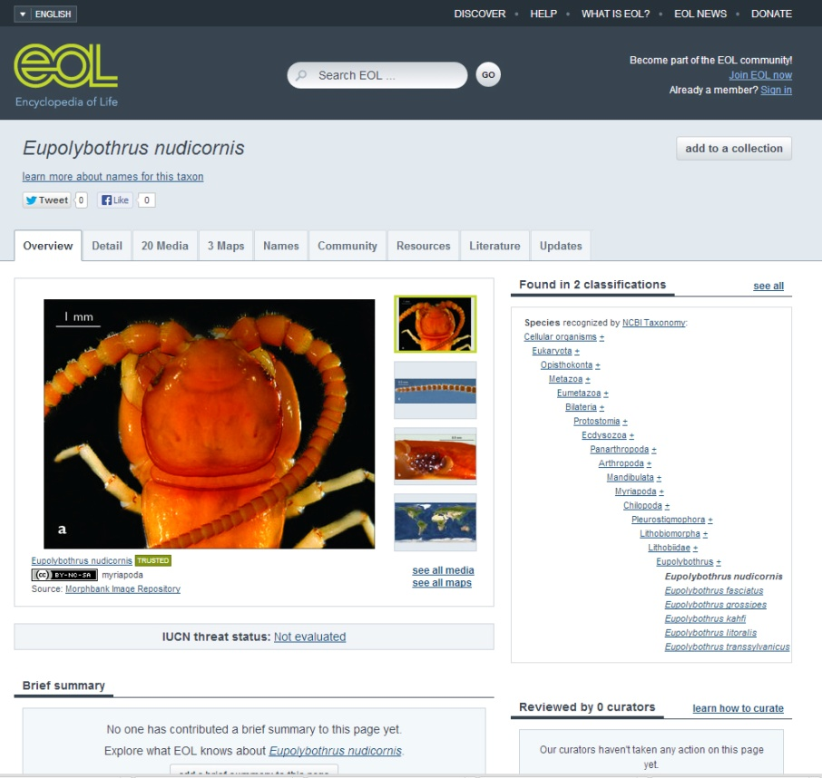
External links

Slide 23
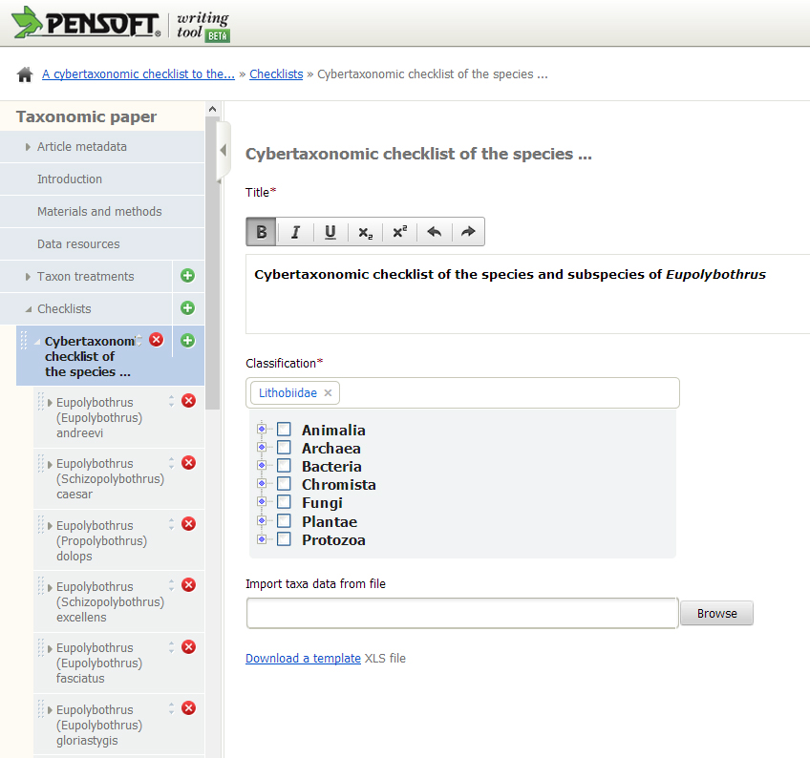
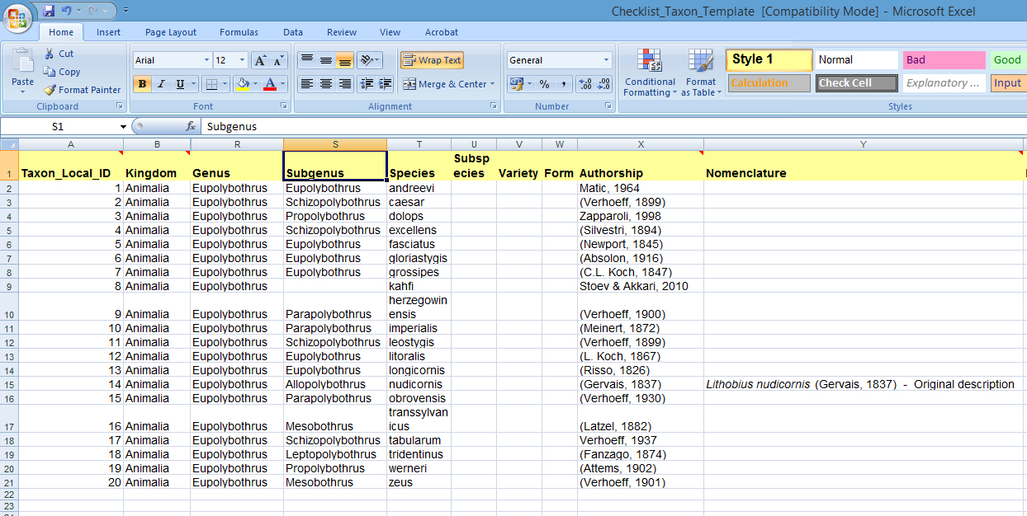
Import of checklists through Darwin Core template

Slide 24
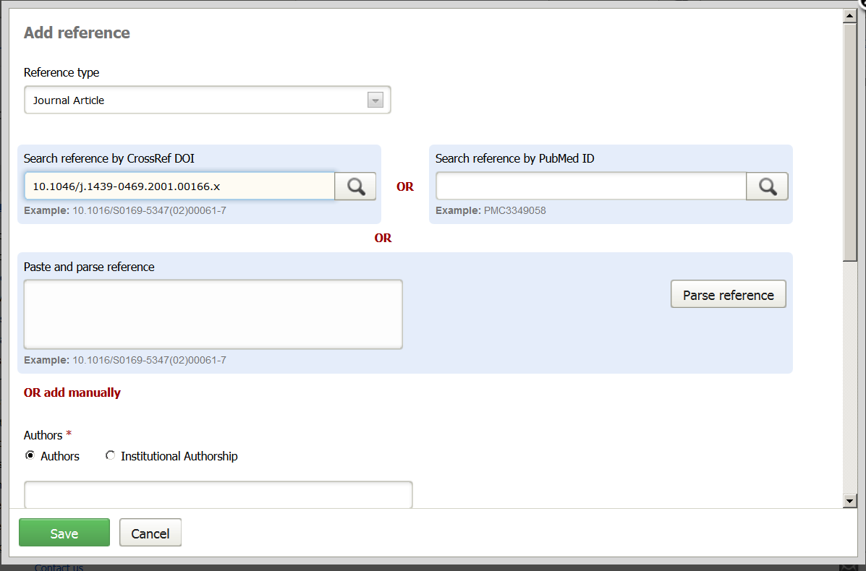

Slide 25
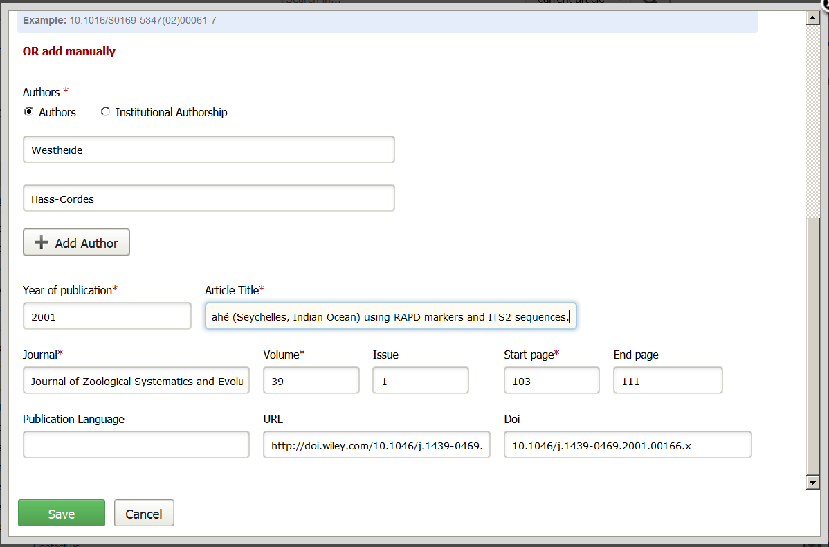

Slide 26
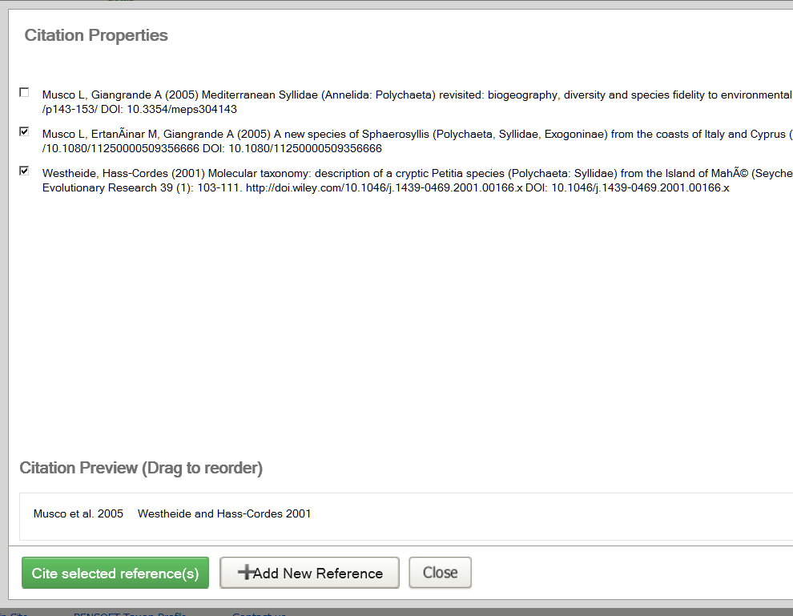

Slide 27


Automated pre-publication registration of new taxa/names
Manuscript
SUBMISSION
Peer review
XML Query
MANUSCRIPT
ACCEPTED
XML Response
XML article metadata
ARTICLE
PUBLISHED
Taxon name available/valid
(effectively published)

Slide 28
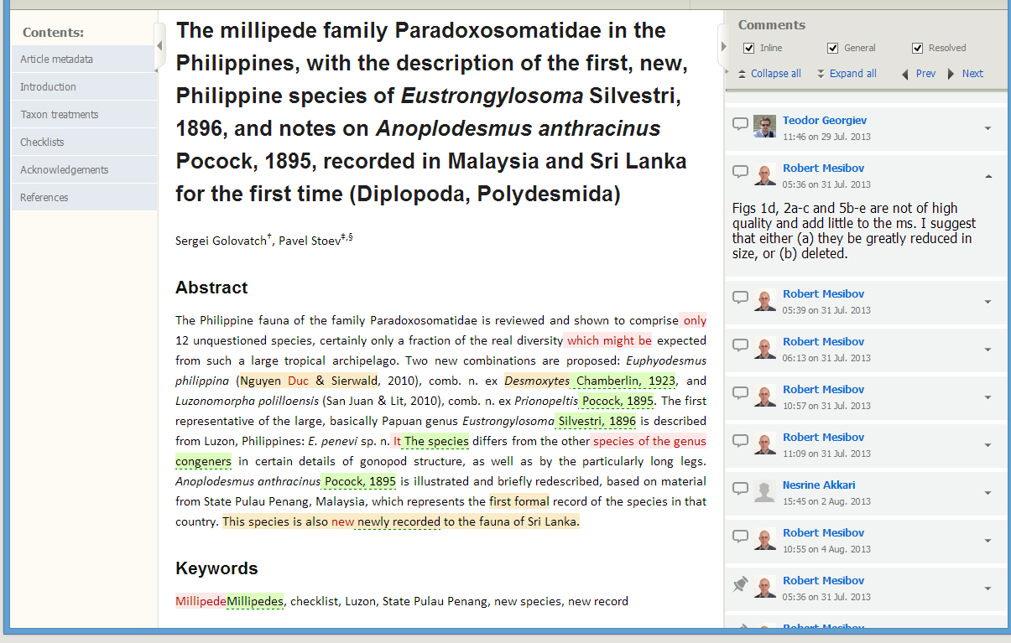
Merging referees and editor’s version into one
Facility for editors

Slide 29
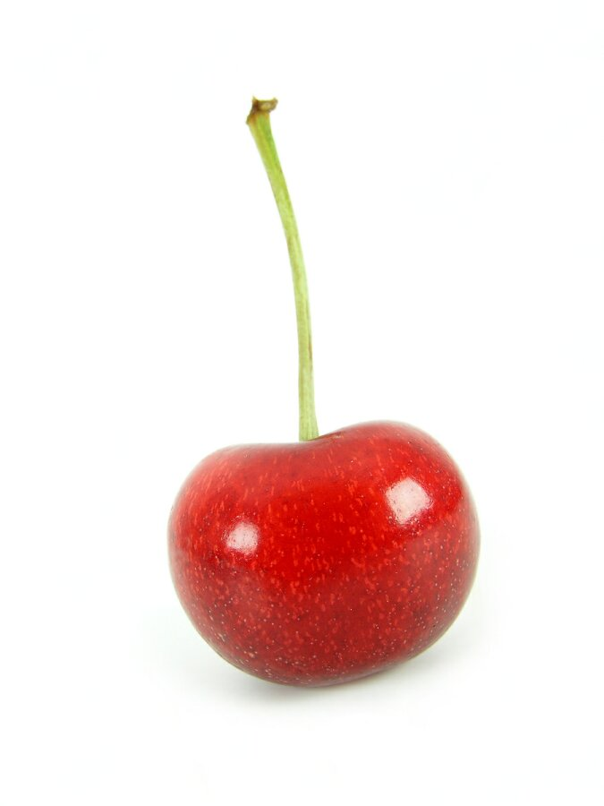

Slide 30
NO Author guidelines!
The tool guides you!

Slide 31
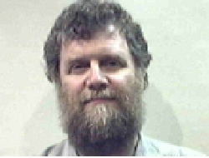
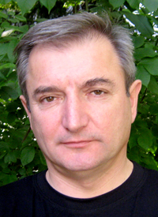





Thank you for your attention!
Dave Roberts
Lyubomir Penev
Laurence Livermore
Jeremy Miller
Teodor
Georgiev
We Open Access!
Vince Smith
ViBRANT

