Slide 1
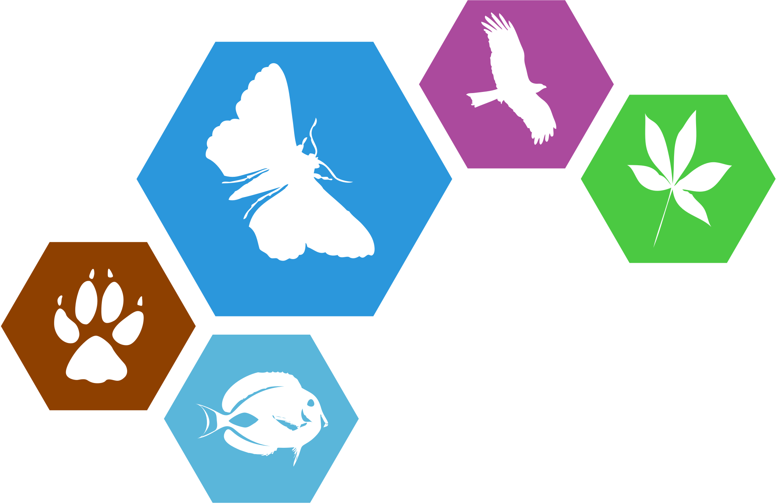
ViBRANT
Virtual Biodiversity
Vince Smith & Dave Roberts
Natural History Museum, London
vince@vsmith.info
Notes:
Slide 1: Title Slide TO DO
Good morning everybody. ViBRANT is a 3-year EU FP7 Research Infrastructure project that was funded under the Virtual Research Communities call and started in December 2010. The acronym ViBRANT ViBRANT stands for Virtual Biodiversity Research and Access Network for Taxonomy, and in many ways that is a very good description of what we are doing. ViBRANT is about setting up the means, tools and infrastructure to produce a more rational and a more effective framework for European Biodiversity research. In this overview slot I will provide an introduction to the ViBRANT project and highlight some of the key progress we have made in the first year of activities.

Slide 2
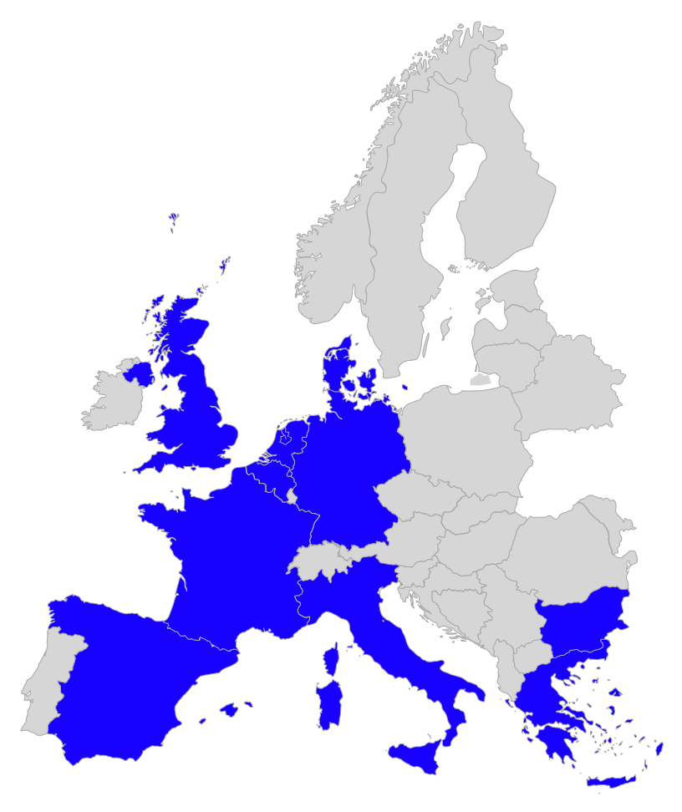



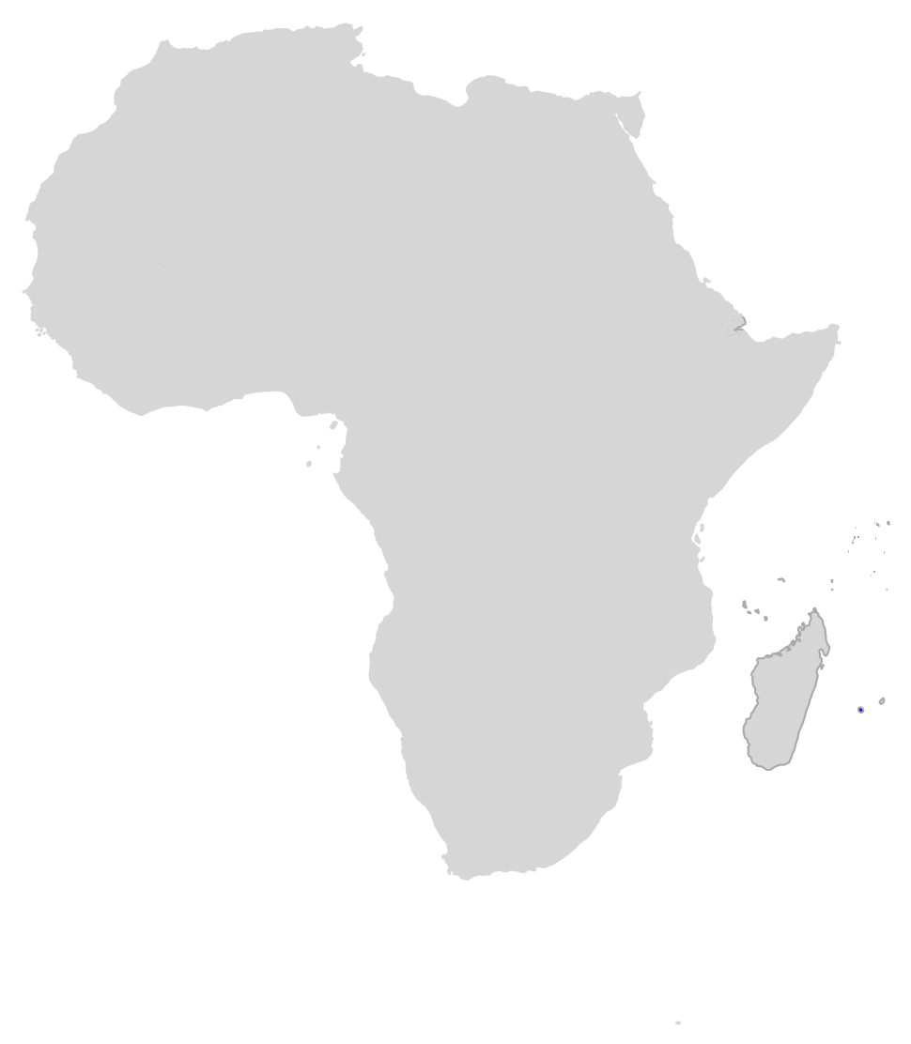















ViBRANT consortium
17 partners in 9 countries
(universities, museums & SMEs)
Interoperability, workflows, services, information modeling & user support
2 of
18
Notes:
2
Slide 4: ViBRANTs contribution
To do this ViBRANT has put together a consortium of 17 partners in 9 different countries, all of whom are specialists in managing and building services on biodiversity data. Either in terms of interoperability, workflows, services, information modeling & user support. The goal of ViBRANT is to federate the activities of these partners in order to provide a more effective framework for European Biodiversity Research.

Slide 3
Biodiversity informatics landscape
Key problems
Landscape is complex, data fragmented & hard to navigate
Many audiences (policy makers, scientists, amateurs, citizen scientists)
Many scales (global solutions to local problems)
Figure adapted from Peterson et al 2010
18
Notes:
3
Slide 3: Biodiversity informatics landscape
This figure shows in broadest terms of the world of biodiversity informatics. Purple boxes are the basic categories of data we are interested in, ranging from genotype and phenotypic information through ecology to data on human effects on biodiversity and biodiversity loss. The yellow boxes show the kinds of biodiversity information products that are generated for these data and are used within biodiversity science. Finally the blank text (which is very small) next to the boxes, are example systems that hold information relevant to each type of information.
Now there are three (or possibly four) fundamental problems that the community have in navigation this information. Firstly the landscape of these systems and data is extremely complex, fragmented & hard to navigate. This is made worse by the fact that there are many different audiences for these kinds of information, each requiring their own specific presentations for these data. Also we have needs for these kinds of information across many different scales. Much of the science we are doing, especially in the field of taxonomy and biodiversity studies, need to happen on a global scale. It requires global standards for software to talk to each other, global workflows to make that process of interaction seamless. However, the practice of taxonomy happens locally. Local groups of scientists, using local infrastructures, and usually with local funders carry it out.
So the real challenge is to link these fragmented activities, to many tem accessible for many audiences across many scales, and to do this in a sustainable way. This is fundamentally the problem that ViBRANT, in conjunction with a number of other initiatives, is trying to address.

Slide 4
ViBRANT Goals
Networking
WP3 Training
Training & outreach
User support systems
Sociology study
WP8 Mobilisation
Field recording support
Citizen science activities
GBIF integration
Visualisation
Vision
Connect people, data & science of biodiversity
WP4 Standards
Data standards
Controlled vocabulary
Data aggregation
Position
Development of a federated network of biodiversity informatics infrastructures (open & sustainable)
Scratchpads
Virtual Research Environment
Scratchpads
as core
virtual platform
WP2 Architecture
Distributed Scratchpad hosting
Software module integration
Sustainability plan
WP5 Data
Phylogenetic analysis
Bioclimatic modeling & metrics
Identification tools
Matrix data editor
Mission
Facilitate the mobalisation, sharing, reuse and publication of biodiversity data
WP7 Literature
Communal literature
Literature mark-up
Data mining
WP6 Publishing
Scholarly manuscript publishing
Data publishing
Research
Service
18
Notes:
4
Slide 5: ViBRANT’s goals
The goal of the ViBRANT project is expressed through our Vision, our Position and our Mission statements, which are shown here.
ViBRANT’s Vision is to connect up the people, data & science of biodiversity, with a focus on Europe, but with an eye on the global landscape of activities. Our position (the way we want to be seen as a project) is through the open & sustainable development of a federated network of biodiversity informatics infrastructures. With out overall mission to Facilitate the mobilization, sharing, reuse and publication of biodiversity data.
We are doing this through a series of NETWORKING, SERVICE, and RESEARCH workpackages which are broken into the major activities shown in this diagram, which I colloquially called “thee chromosome” because this is in effect the DNA of ViBRANT.
Our networking Activities are split into 4 workpackages. These are WP3, which is primarily about training and study of our user community, which feeds bask into our development work plan. WP4 is about standardisation in its broadest sense and WP8 is about the more effective mobilisation of taxonomic data into the ecological and conservation communities
Our service activities are split into two workpackages and primarily concern data analysis and publishing services on data within the network.
Finally under our two research workpackages are about enhancing and expanding our technical architecture. WP2 primarily concerns the technical architecture of the Scratchpads, which are a central hub component of ViBRANT and provide the mechanism with which we reach out users. WP7 is concerned with access and extraction of information from biodiversity literature, which is a fundamental resource to the biodiversity science community.

Slide 5
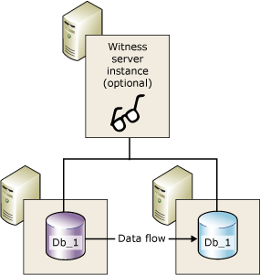
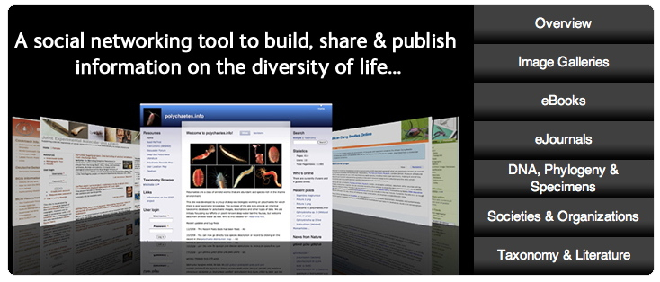
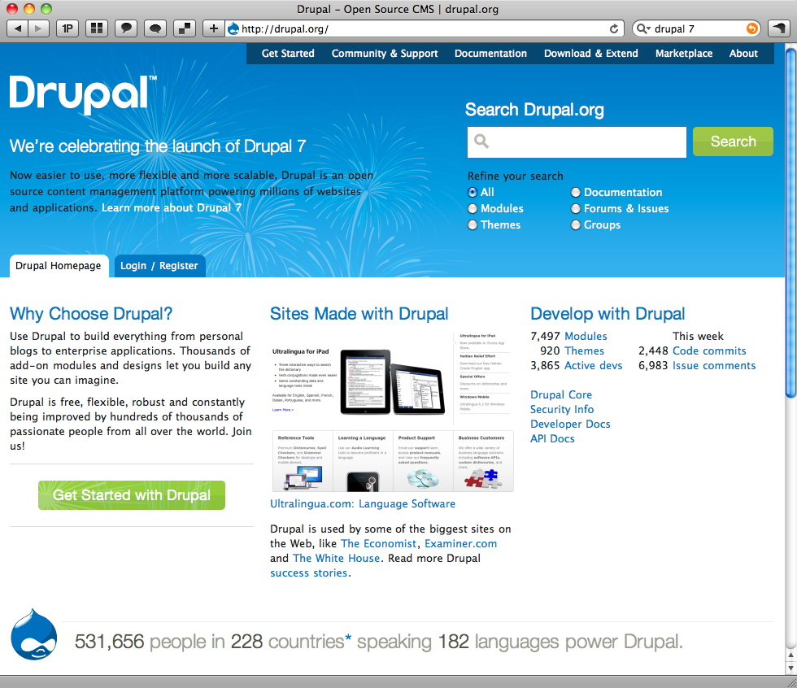
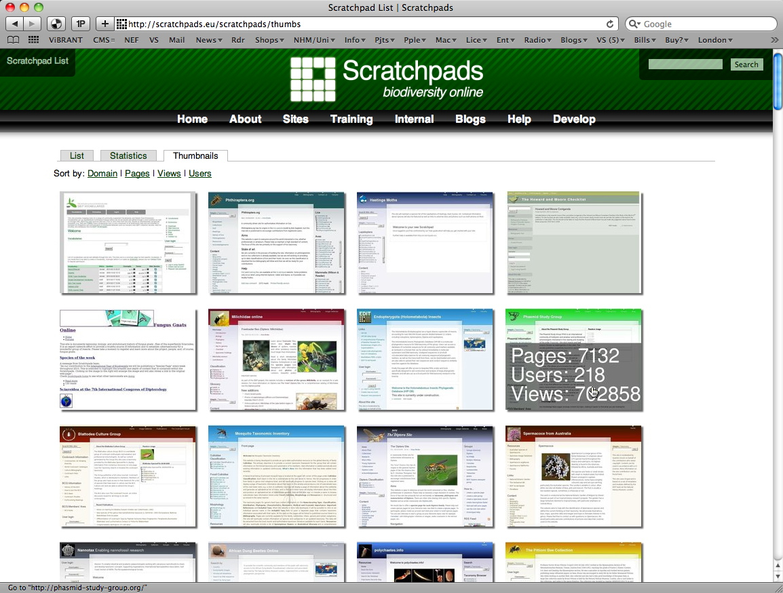
WP2 Highlights: Technical architecture
RESEARCH
Distributed Scratchpad hosting
  Mirroring & failover
New hosting infrastructure
  Aegir > new hosts easy to add
Scratchpad upgrade SP1 > SP2
  Complete rewrite, Drupal 6 to 7, 70 contrib. 45 SP modules
18
Notes:
5
Slide 14: WP2: Technical architecture
NHM with BGBM
Distributed Scratchpad hosting (NHM / BGBM)
Mirroring & failover
New hosting infrastructure (NHM)
Aegir > new hosts easy to add (Kew, MBL, GBIF)
Scratchpad upgrade SP1 > SP2 (NHM)
Complete rewrite, Drupal 6 to 7, 70 contrib. 45 SP modules

Slide 6
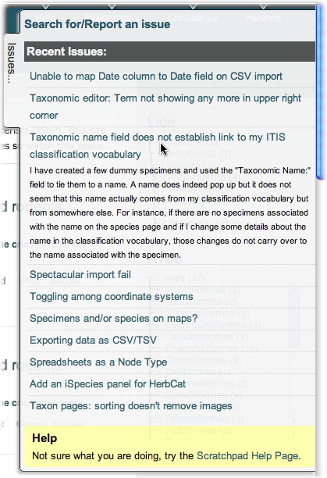
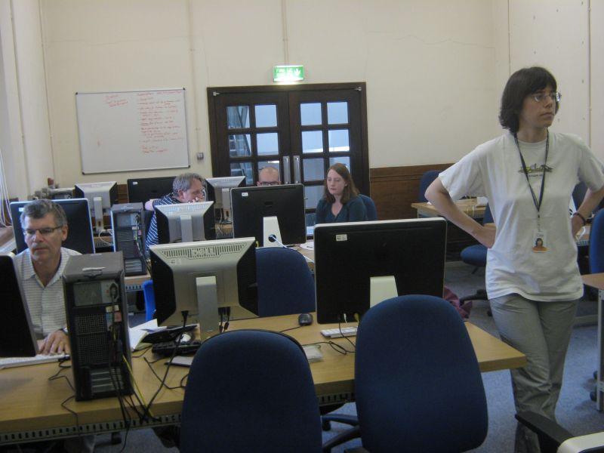
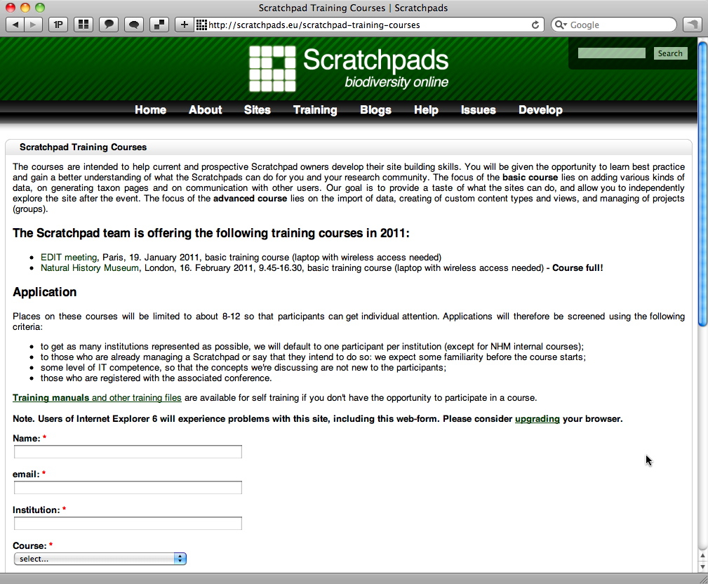
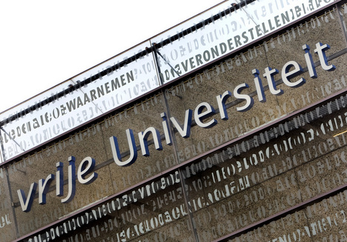
WP3 Highlights: Training, outreach & community support
NETWORKING
Training
  6 courses, ambassador programme (12) & integrated help syst.
User study
  Society study of user needs & user metrics
Outreach
  Help desk, promotion & bug / feature request management
18
Notes:
6
Slide 9: WP3: Training, outreach & community support
RBINS with VU & NHM
Training (RBINS / NHM)
6 courses, ambassador programme (12) & integrated help syst.
User study (VU)
Soc. study of user needs & user metrics > inform yr 2 activities
Outreach (RBINS / UNITS)
Help desk, promotion & bug / feature request management

Slide 7
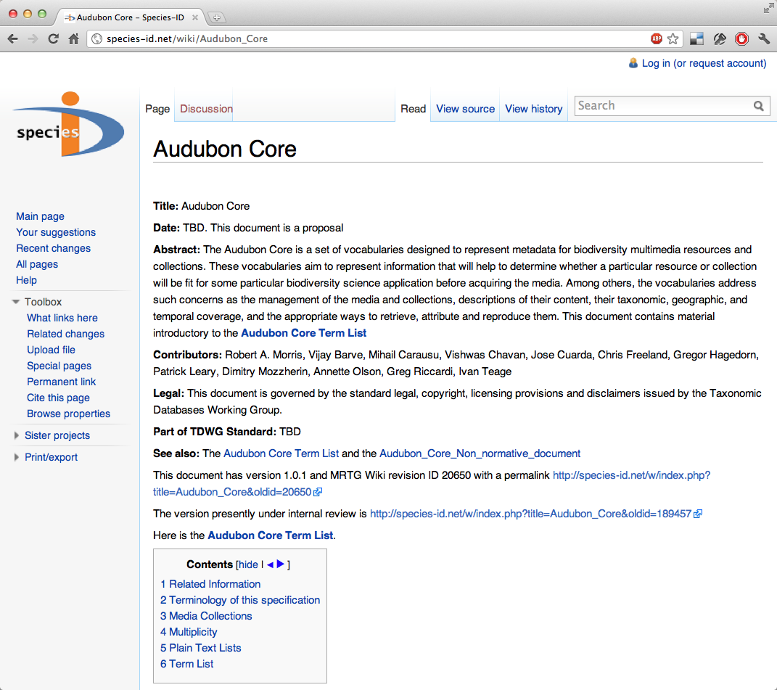
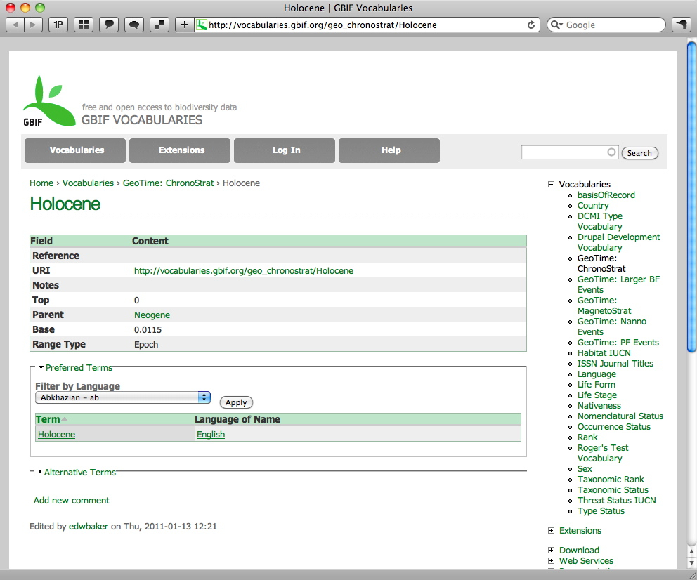
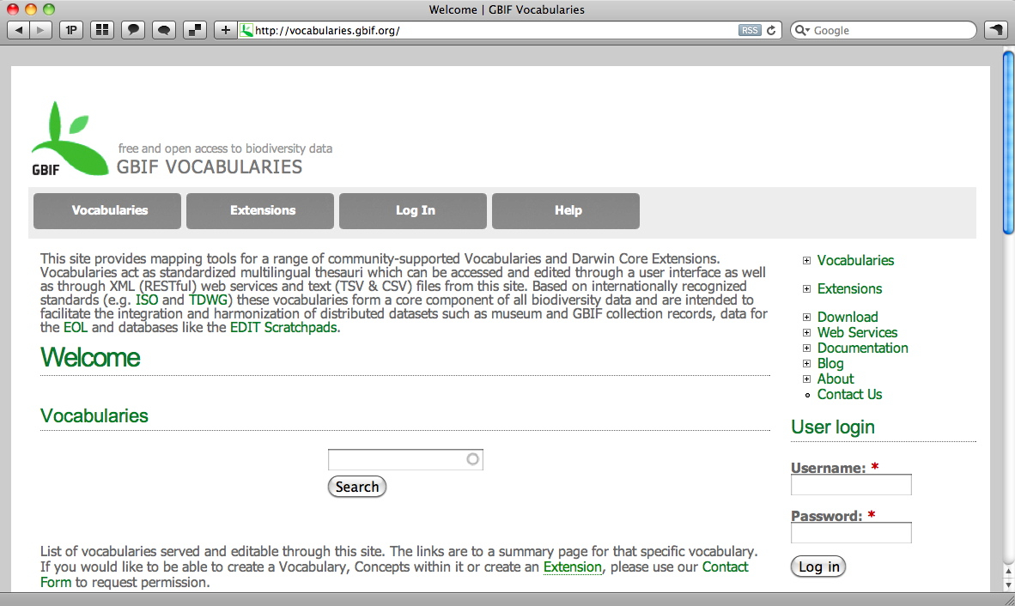
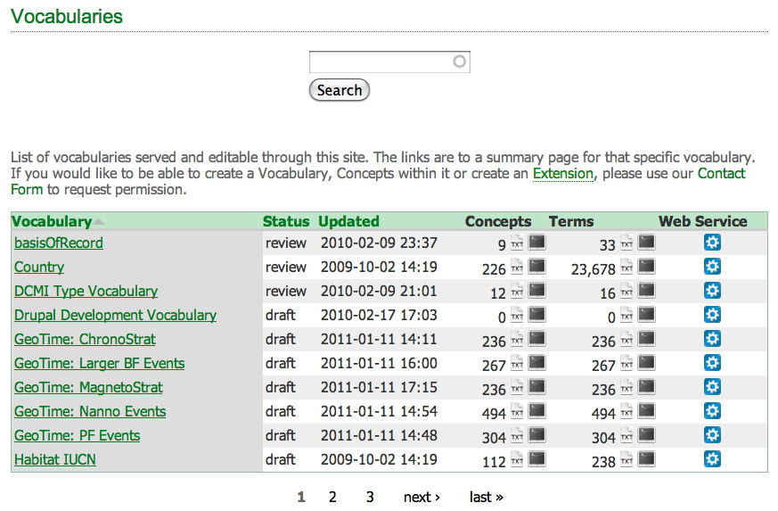
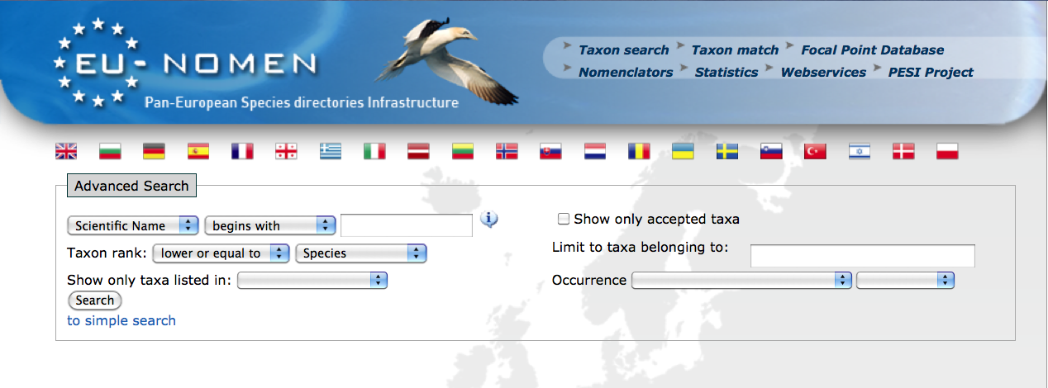
WP4 Highlights: Standardisation
NETWORKING
Controlled vocabularies / ontologies
  GBIF voc services, TDWG / KOS, Sp-ID vocab.
Standards control & management tools
  Species-ID (Sem. Media Wiki's)
Cross-platform data integration
  DwC-A module for SP2, feeds to CDM in yr. 2
Liaise with major initiatives
  LifeWatch, PESI, EOL, BHL, EU-BON…
18
Notes:
7
Slide 10: WP4: Standardisation
UvA with JKI, PENSOFT, GBIF, BGMB
Controlled vocabularies / ontologies (GBIF / JKI)
GBIF task group report, TDWG KOS symposium, Sp-ID vocab.
Standards control (JKI)
Species-ID (Sem. Media Wiki [RDF]), vocabs. , licensing
Cross-platform data integration (BGBM, UvA)
DwC-A module for SP2, feeds to CDM in yr. 2
Liaise with major initiatives (UvA)
LifeWatch, PESI, EOL, BHL, EU-BON…

Slide 8
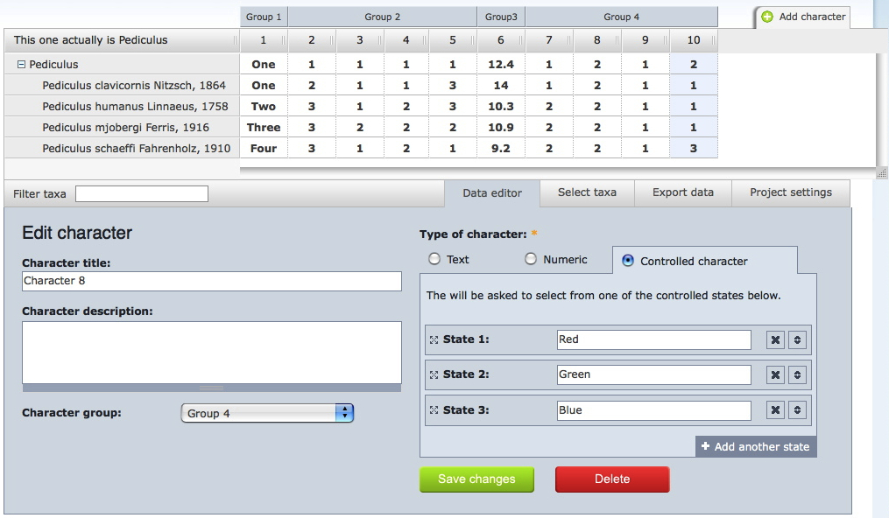
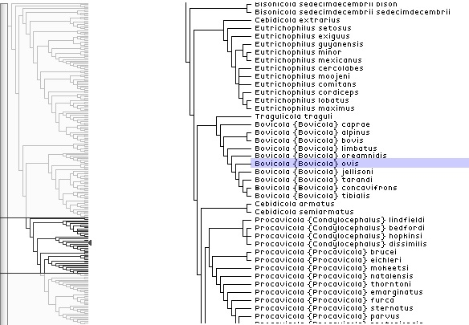

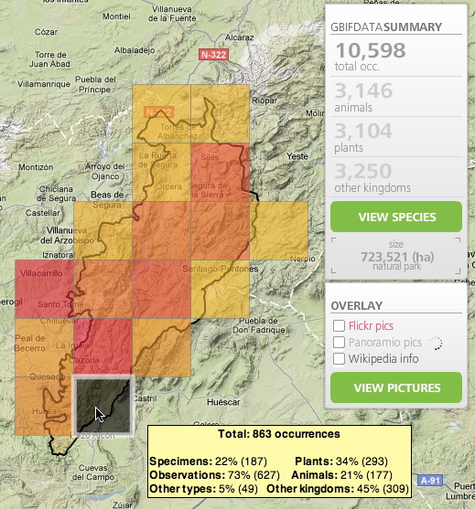
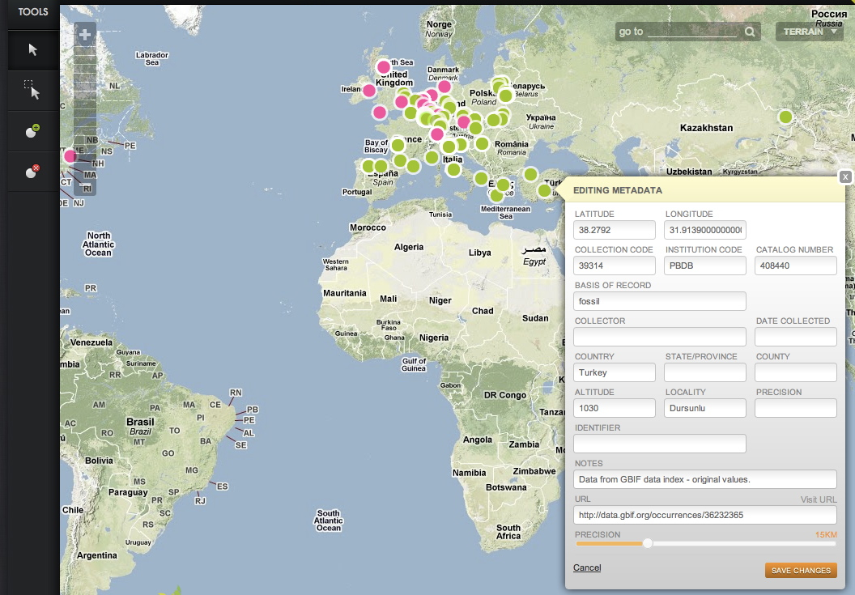
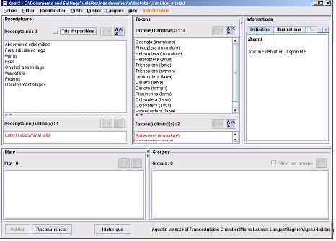
WP5 Highlights: Data services
SERVICE
Data (pre-)processing & external linking
Oxford Batch Operation Engine
  Multi-platforms support for comp. intensive services
Key construction
  Enhancements to Xper2 & integration as a service
GeoCat conservation assessments
  Import data, range maps, niche overlays
18
Notes:
8
Slide 12: WP5: Data services
UOXF with UPMC, JKI, Vizz, UdIR
Oxford Batch Operation Engine (UOXF)
Multi-platforms support for comp. intensive services
Key construction (UPMC / UdIR)
Enhancements to Xper2 & integration as a service
GeoCat conservation assessments (Vizz)
Import data, range maps, niche overlays

Slide 9
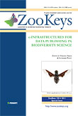
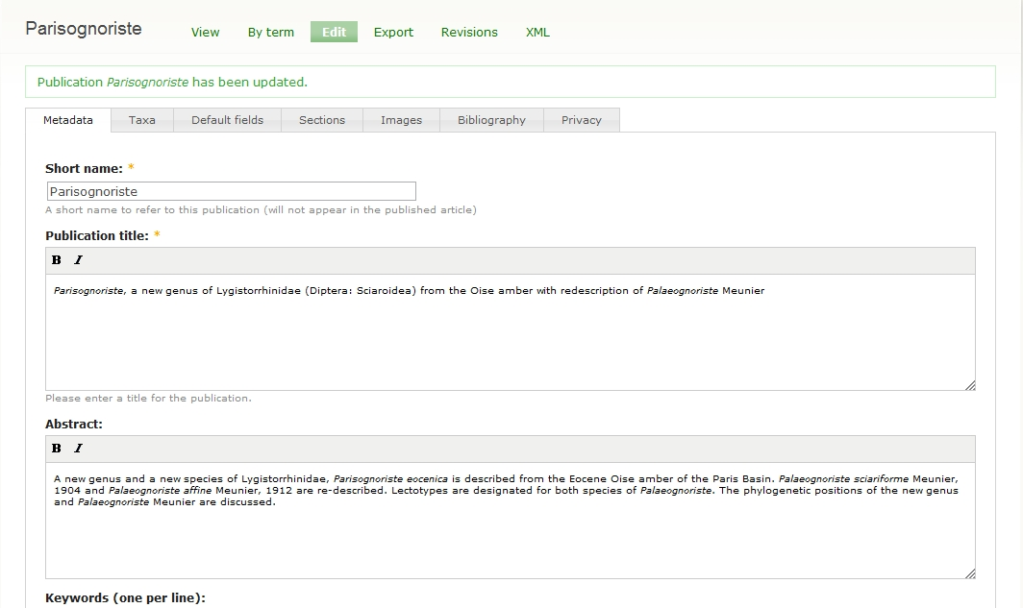
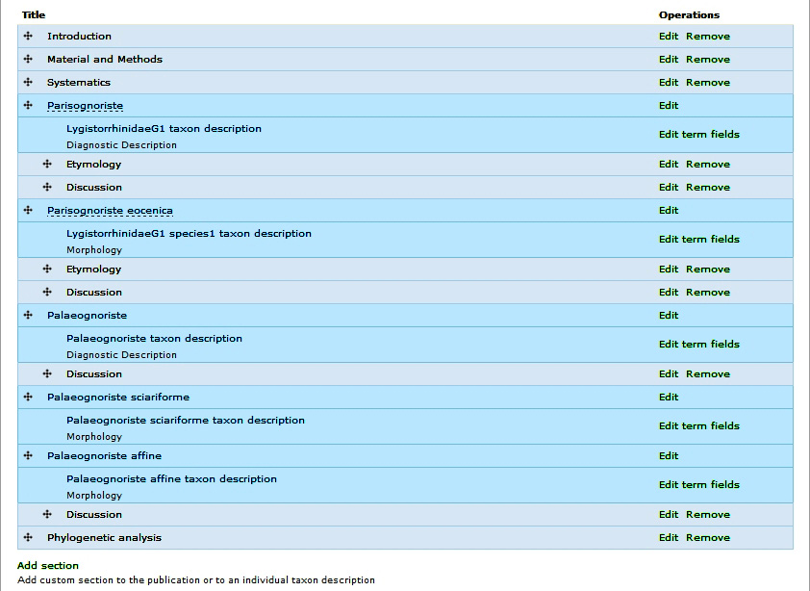
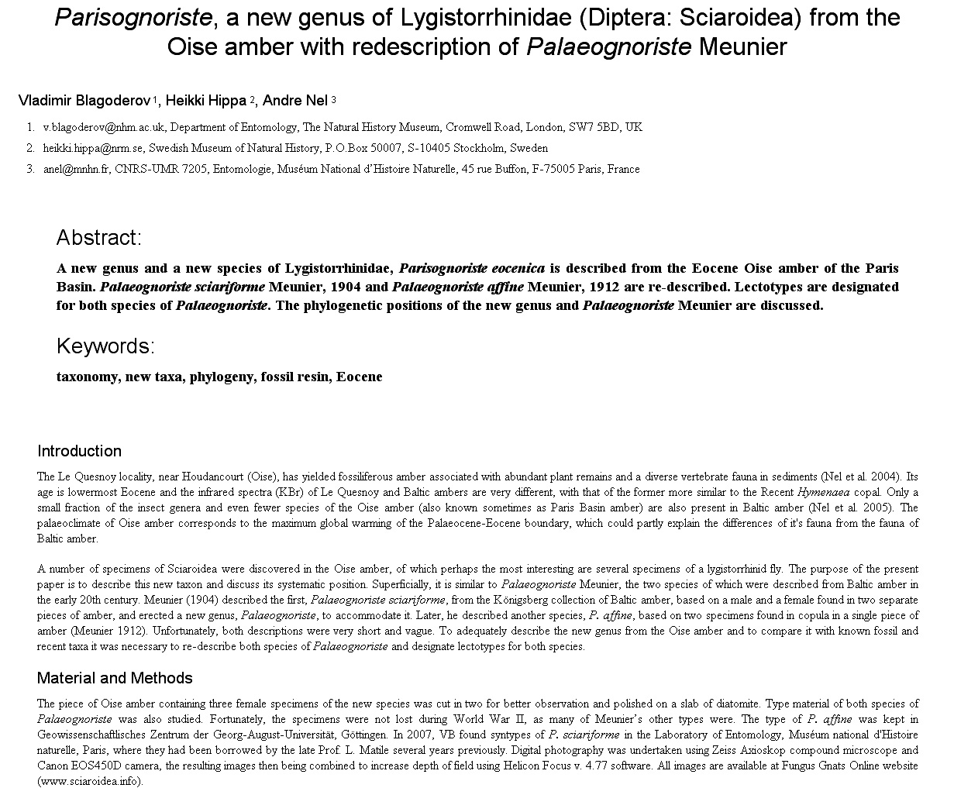
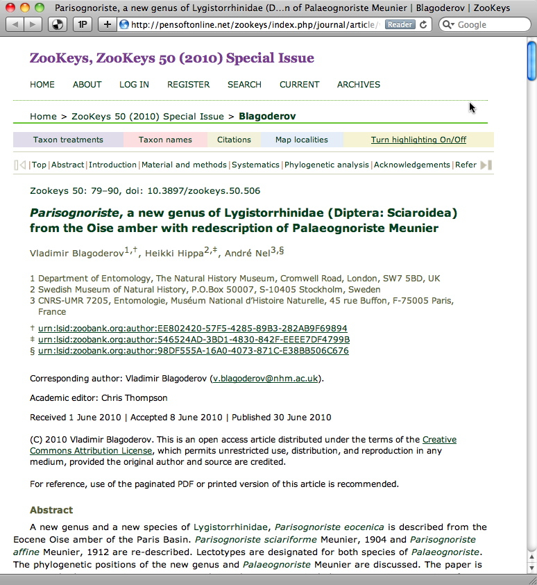



WP6 Highlights: Scholarly publishing
SERVICE
XML Publication workflows for SP2
  Workshops, publishing from a Scratchpad to Zookeys & Phytokeys
  Content pushed to multiple outlets
  EOL, Species-ID, GBIF species pages
ViBRANT Special Issue
  e-Infrastructures for Data publishing
XML
HTML
PDF
18
Notes:
9
Slide 13: WP6: Scholarly publishing
PENSOFT with NHM
XML Publication workflows for SP2 (PENSOFT / NHM)
Workshops, publishing from a Scratchpad to Zookeys & Phytokeys
Content pushed to multiple outlets (PENSOFT / NHM)
EOL, Species-ID, GBIF
ViBRANT Special Issue (PENSOFT /NHM)
e-Infrastructures for Data publishing

Slide 10
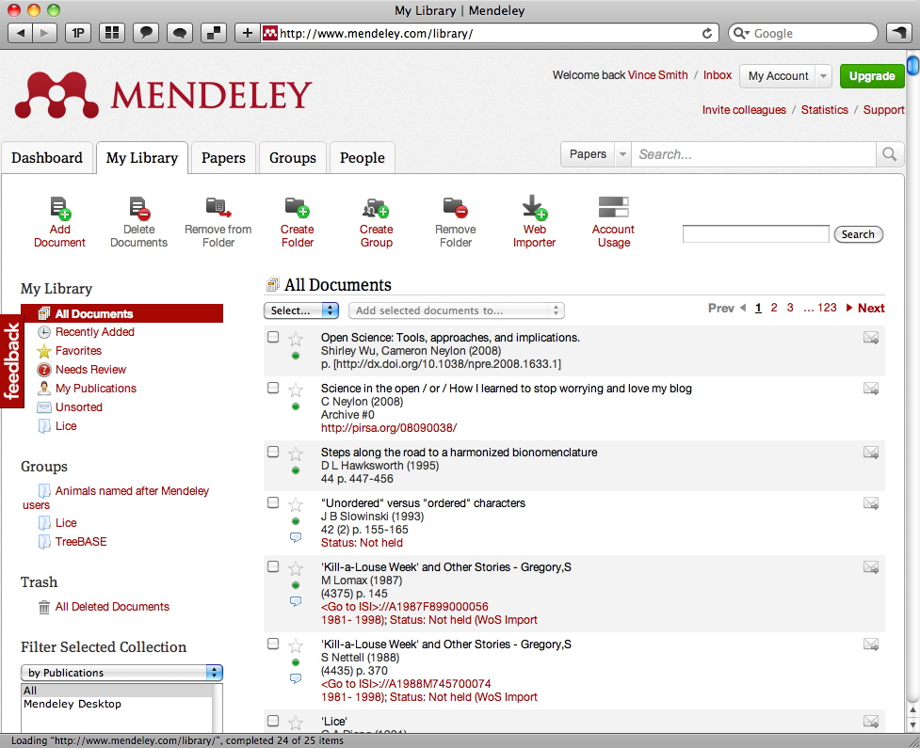
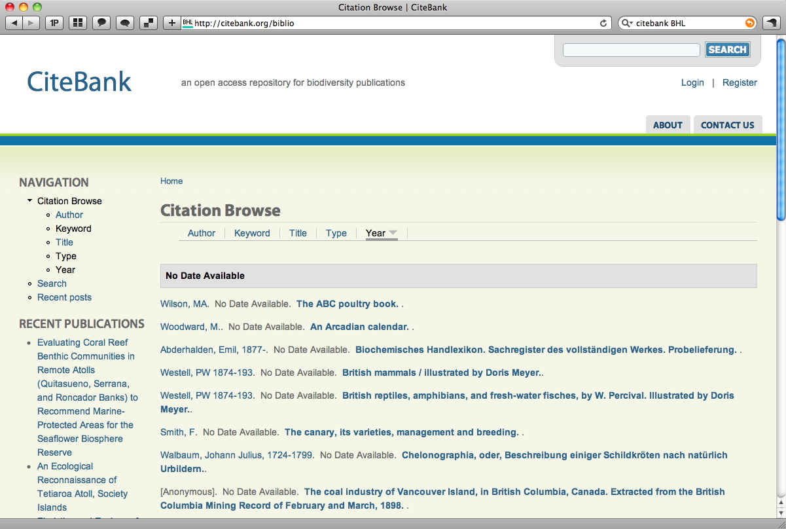
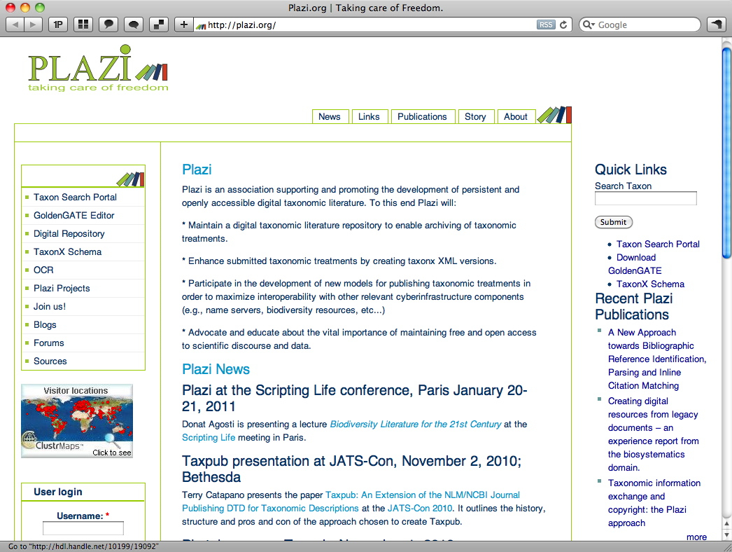
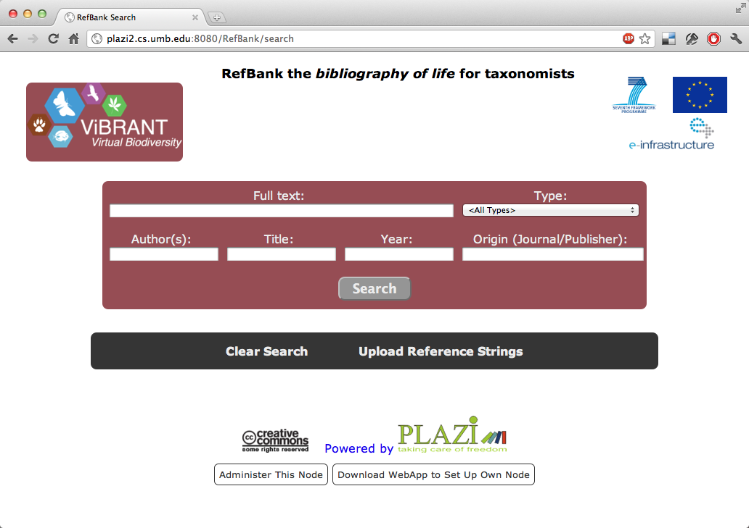
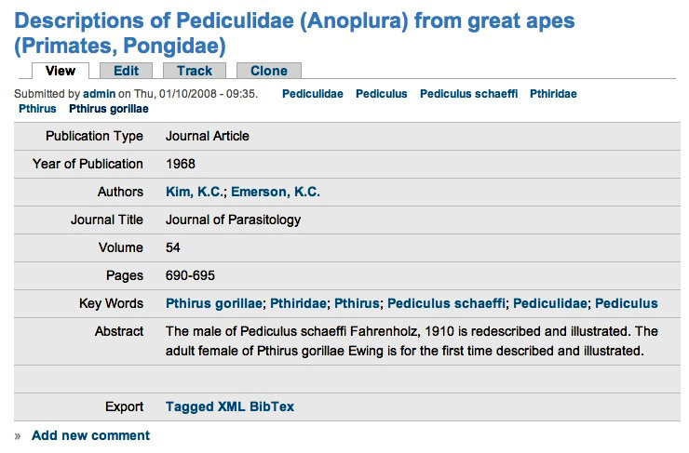
WP7 Highlights: Biodiversity literature access
RESEARCH
Community bibliography
  ZooKeys Review, RefBank implementation “dirty bucket”
Article level de-duplication
  Test-cases developed
Biodiversity lit. markup
  GoldenGATE simplified & extended, ZooKeys lit. markup review
18
Notes:
10
Slide 15: WP7: Biodiversity literature access
OU with KIT, PENSOFT, NHM
Community bibliography (OU)
ZooKeys Review, RefBank implementation “dirty bucket”
Article level de-duplication (OU)
Test-cases developed
Biodiversity lit. markup (KIT / OU / PENSOFT / NHM)
GoldenGATE simplified & extended, ZooKeys lit. markup review

Slide 11
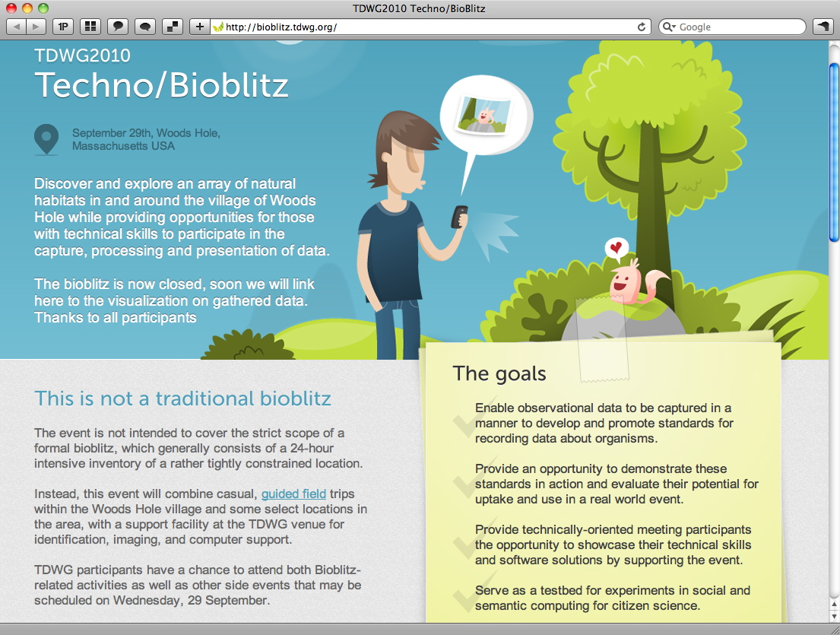
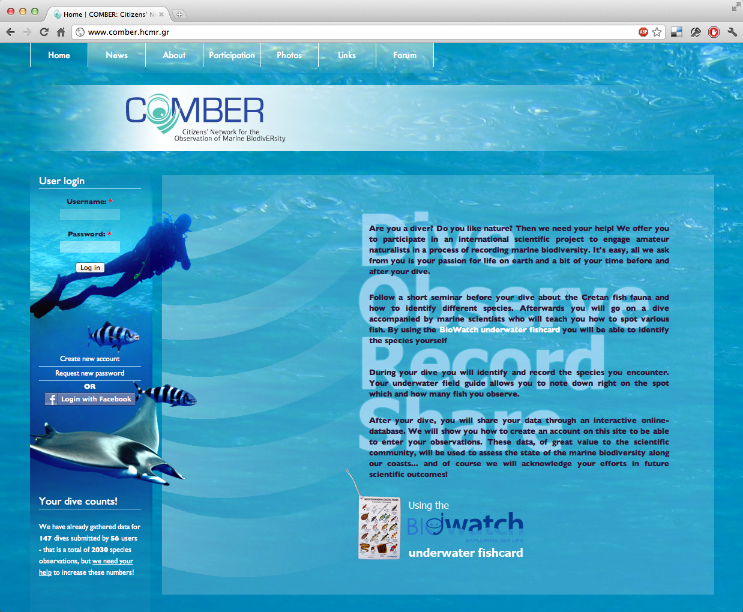
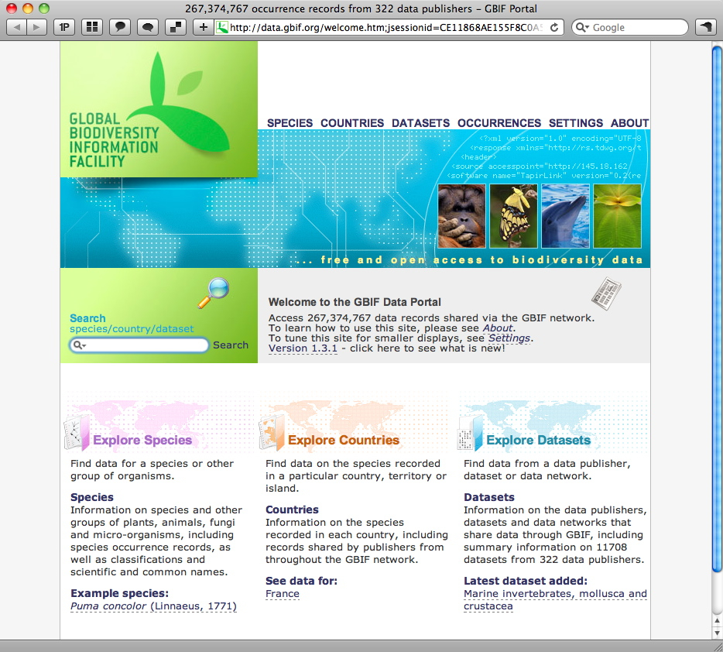
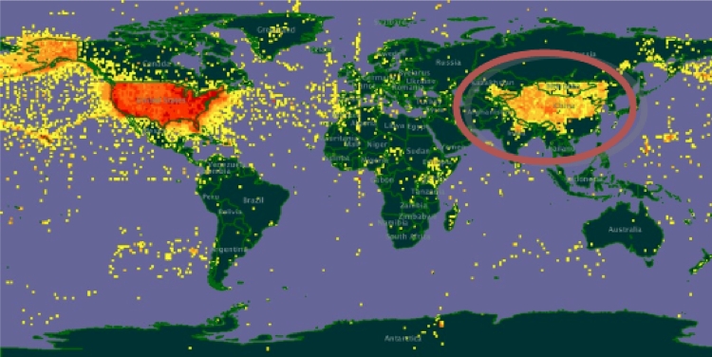
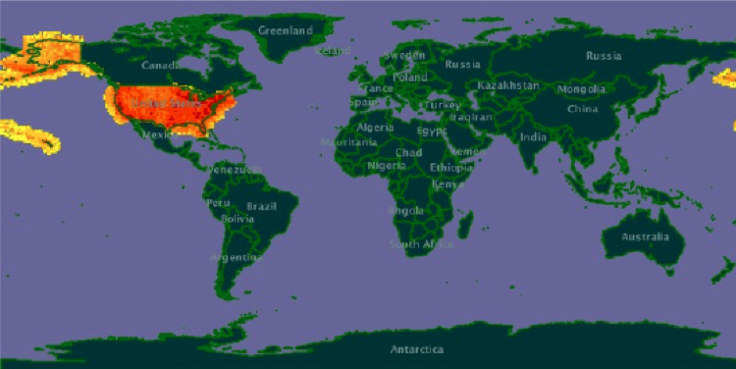
WP8 Highlights: Data mobilisation modules
NETWORKING
Citizen Network for the Observation of Marine BiodivERsity
  COMBER dive club programme & 2 papers
GBIF data improvement
  Algorithms for misinterpretations & costal regions
Ecol. & conservation module
  Routines for indices written (starts Feb. yr 2)
Mobile field recording
  Review report (immature tech., mobile style sheets)
18
Notes:
11
Slide 11: WP8: Ecol. & conservation data mobalisation
HCMR, MfN, Vizz, PENSOFT, GBIF
Cit. Net. for the Obs. of Marine BiodivERsity (HCMR)
COMBER dive club programme & 2 papers
GBIF data improvement (GBIF)
Algorithms for misinterpretations & costal regions
Ecol. & conservation module (HCMR)
Routines for indices written (starts Feb. yr 2)
Mobile field recording (MfN)
Review report (immature tech., mobile style sheets)

Slide 12
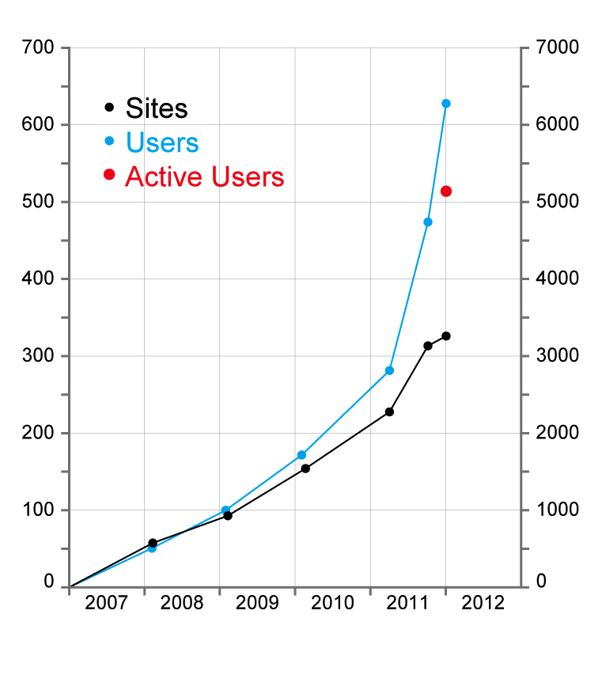
Key Impacts
Scratchpad Usage
Sites 326
Users 6279
Active Users 5139
(273 w / 759 m)
Total pages 424,972
Publications
Sites
Users
Special Issue (20 papers)
Platforms, components & users
6 other (non-conference) papers
Events
32 presentations
26 workshops
3 flyers
2 exhibitions
2 posters
ViBRANT
SP 2
Scripting-Life ViBRANT conference
47 presentations (mostly lightning talks)
18
Notes:
12
Slide 17: Key Impacts
This slide puts some figures on some key elements of these activities, which provide a measure of the impact ViBRANT is having.
Scratchpad Usage
With respect to the Scratchpads there has been substantial growth in the number of users and the number of project sites that have been established during 2011. You can see from this grate that the rate of growth has rapidly accelerated. This has just started to tail off at the end of 2011 as we advised new users to wait until the new version of the Scratchpads has been released next month. Nevertheless, the growth is still very significant.
In terms of publications we published the ViBRANT special issue looking an e-infrastructures for data publishing. This includes 20 papers looking at different data publishing platforms, modules of software and crucially how people are using the infrastructure. In fact half of the special issue (10 papers) was devoted to this topic of how people are using ViBRANT infrastructure and these papers were written by members of the user community.
ViBRANT project partners have taken given 32 presentations in the first year of the project, and attended 26 workshops, produced 3 flyers, attended 2 exhibitions and produced 2 posters.
Finally we have the Scripting Life opening conference in Paris which had 55 delegates and included a further 47 presentations (although most of these were lightening talks) covering various parts of the biodiversity informatics landscape.

Slide 13
Collaboration with GBIF nodes
Promote Scratchpads as tool for data capture (monitoring / mobilisation)
  Dive clubs, Citizen Scientists, crowd sourcing, Taxonomic Societies, etc.
Promote Scratchpads as data a virtual work bench for taxonomists
  Standardised access to libraries, vocabularies, distributional data, pictures, etc.
Promote Scratchpads as a publishing tool
  Advanced workflows for data publishing
Promote Scratchpads ontologies / vocabularies management tool
  Advanced MediaWiki's facilitating community involvement
Promote Scratchpads as a platform for 'proto-GSDs' development
  Contributing to –for instance– CoL/Species2000
Possibility to use Scratchpads as a front-end for Virtual e-Labs
  Link to BioVel

