Slide 1
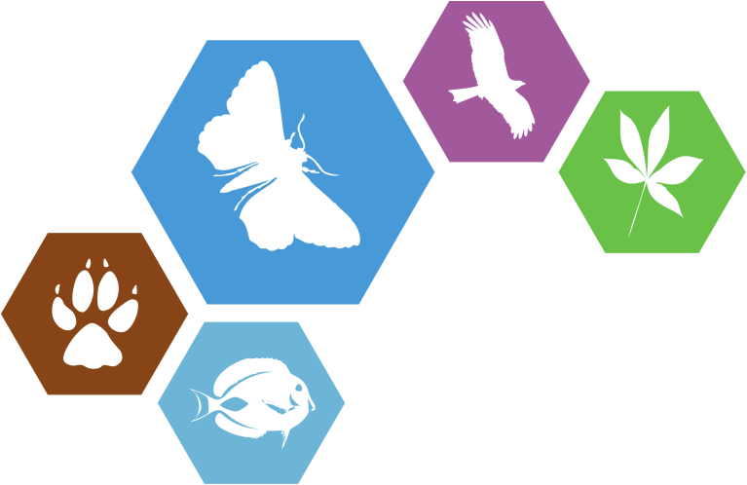
Workshop 5: Bibliographies in a changing landscape
ViBRANT
Virtual Biodiversity
David Morse, The Open University, UK, David.Morse@open.ac.uk
David King, The Open University, UK, David.King@open.ac.uk
BIH2013 workshop, Sapienza University, 6 September 2013

Slide 2
Agenda
Introduction
The wider landscape
The bibliography of life
ViBRANT tools
RefBank
ReFinder
The future
Linked open data

Slide 3
Agenda
Introduction
The wider landscape
The bibliography of life
ViBRANT tools
RefBank
ReFinder
The future
Linked open data

Slide 4
Citing to survive
Standing on the shoulders of giants
As good academics we will cite the source…
Notes:
Why cite at all?
Because our work builds on others
As in this well known phrase
But who actually said it first?
In the UK often attributed to Sir Isaac Newton, “If I have seen further it is by standing on the shoulders of giants.”
However, it does seem to have been used earlier. For example, John of Salisbury writing in his Metalogicon of 1159 attributed it to Bernard of Chartres However, there are other references too.
Which is why we – as good academics – cite our sources. Whose work are we building on? Whose shoulders are we standing on?

Slide 5
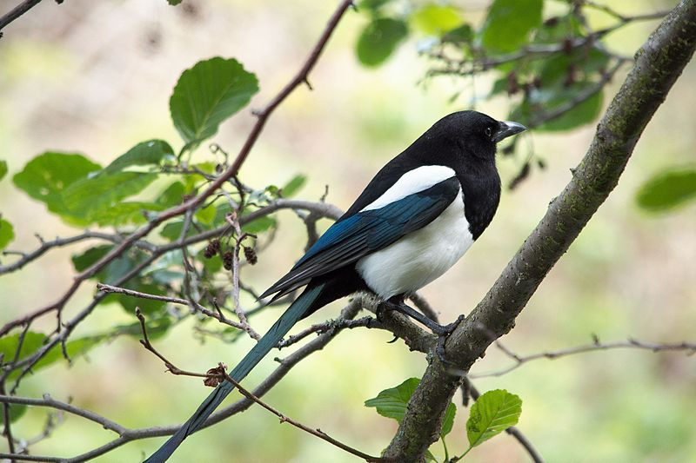
Citing to survive
Pica pica (Linnaeus, 1758)
Linnaeus, C. 1758: Systema Naturae per regna tria naturæ, secundum classes, ordines, genera, species, cum characteribus, differentiis, synonymis, locis, Tomus I. Editio decima, reformata. Holmiæ: impensis direct. Laurentii Salvii. i–ii, pp 1–824 doi: 10.5962/bhl.title.542: pages 106–107.
14
Notes:
Taxonomists do more than just cite full bibliographic references as other academic disciplines do.
Also have short hand of author, year for species = that species concept as originally defined.
Hence production and use of flora, fauna and mycota to support accurate fieldwork. Identified specimens can be tied back to definite concepts.
You will not survive as an academic unless you cite!
This slide shows that even that simple injunction can lead to trouble.
How many spelling variations have you seen for Linnaeus?
How many name variations have you seen for Systema Naturae?

Slide 6
Citing to survive
You have to be accurate:
Kimura, M. (1980) A simple method for estimating evolutionary rate of base substitutions through comparative studies of nucleotide sequences. J. Mol. Evol., 16, 111–120
Kimura, M. (1980) A simple model for estimating evolutionary rate of base substitutions through comparative studies of nucleotide sequences. J. Mol. Evol., 16, 111–120
Notes:
Note variant form with *model* replacing *method*.
Worse, it persists.
In October 2012 when we were investigating this phenomenon:
Google Scholar *method* has 11,614 citations, *model* had 1.
MS Academic Research *method* has 5,725 citations, *model* had 165.

Slide 7
Citing to survive
Enough of the problems…
What of the solutions?
Notes:
After a quick introduction to some of the problems…

Slide 8
A little history
Notes:
An image of bibliography management hardware
All students encouraged to build up their own library
Useful could add notes to the raw metadata too
Shareable within the office
Usually indexed on author names

Slide 9
A little history
AALBERSE, R. C., VAN LEEUWEN, J., WITTEMAN, A. & AKKERDAAS, J. H. 1993. IgE antibodies to insects in mite-positive sera: co-sensitization or crossreactivity. Forty-ninth Annual Meeting of the American Academy of Allergy and Immunology, Chicago, Illinois, USA, March 12-17, 1993. Journal of Allergy and Clinical Immunology 91: 284.
AARON, S. F. 1883. Description of new Psocidae in the collection of the American Entomological Society. Transactions of the American Entomological Society 11(1884): 37-40, pl. IX. (This paper was published in December 1883).
AARON, S. F. 1884. Collecting on the Gulf Coast of Southern Texas. Papilio 4(9-10): 159-161.
AARON, S. F. 1886. On some new Psocidae. Proceedings of the Academy of Natural Sciences …
Notes:
Once computers were being more widely used for writing so lists of references were compiled.
Standalone software applications were written with varying degrees of technical ability to manage bibliographic collections on the new PCs.
Indeed, early versions of Windows came with a free program CardFile, based on the concept of a deck of 5x3 cards.
However, these have many issues:
the references are not easily shareable
no standard format imposed
rely on accurate typing
Etc
Note, many researchers still use such files today, usually to avoid having to learn how to use bibliographic reference software.

Slide 10
A little history
@article {234,
title = {Descriptions of three new species of Psychodidae (Diptera) from the southeastern United States},
journal = {Zootaxa},
volume = {2524},
year = {2010},
pages = {51-62},
author = {Curler, Gregory R. and John K. Moulton}
}
Notes:
Once computers were being more widely used for writing so lists of references were compiled.
Many workers in mathematics and the ‘hard’ sciences adopted LaTeX to meet their peculiar layout needs.
Alongside LaTeX a standard for bibliographic references was designed: BibTeX.
This is not provided the complete reference, but broke it down into its component forms. This opened the ability to easily reformat references to meet different presentation standards. It also made sharing references by copying BibTeX files feasible.
Is still in use today. Indeed, it is supported by the tools you will see later in the workshop.

Slide 11
A little history
Notes:
More tools were developed, and standard writing software such as StarOffice – predecessor to today’s OpenOffice – even came with a bibliographic database built in.
Clearly, this made sharing references within a team, who all use the same software, far easier than before.
Early attempts to share references were domain specific. One of the earliest, starting in the 1970’s was agris.
“The AGRIS initiative was set up by the FAO in the 70s and created a worldwide cooperation for sharing access to agricultural science and technology information. Based on available technologies, AGRIS was initially collecting bibliographic references for a central database. ”
It is still in use today, having made the transition to the web. We will meet agris again later in the workshop as it is one of the leaders in the transition to linked open data.

Slide 12
A little history
Notes:
Here’s another example of an early domain-specific initiative that has made the transition to the web:
As Wikipedia puts it: DBLP originally stood for DataBase systems and Logic Programming. As a backronym, it has been taken to stand for Digital Bibliography & Library Project, however it is now preferred that the acronym be simply a name, hence the new title "The DBLP Computer Science Bibliography".
From DBLP’s home page: “This server provides bibliographic information on major computer science journals and proceedings.”

Slide 13
A little history
Notes:
And it was the internet that made the difference. Instead of having to gain inter-institution access to a dedicated domain specific server, the internet made sharing data far easier.
Arguably the first bibliographic tool to exploit the internet was CiteSeer, back in 1998.
Aiming to cover all academic and scientific papers, it was generally taken up by computer and information scientists first because they already had made the move to computer based files and had their references formatted.
It was replaced in 2008 by CiteSeerX as the original architecture could not scale. As you can see it still exists, and has adopted a fashionable minimalist home page.

Slide 14
A little history
Notes:
Since then CiteSeer has inspired many similar services that have come and gone. Though two deserve a special mention: Microsoft Academic Search (simply because it is MS and so has some traction) and Google Scholar. Note the fashionable minimalist home page, and that tag line ☺.
But mention of Google Scholar has moved on from web 1.0, the simple enabling of passive access, and introduces web 2.0 to our story. See for example, ‘My Citations’ at the top of the screen.

Slide 15
A little history
Notes:
Alongside developments on the ‘net, with the growing power of desktop PCs so the standalone bibliographic software tools became more sophisticated. Dominant in this market was EndNote eventually bough by ThomsonReuters.
Originally for the Mac, EndNote 2 it was available for Windows too.
EndNote is a sophisticated database system bringing to an individuals machine the sort of capabilities that previously needed a central server like dblp or agris to deliver. EndNote also exploited the local processing power to offer more features, more formats for export, PDF output, and ultimately to import PDFs too. The tools moved beyond references to storing the documents themselves.
And with this growing sophistication locally, and the need therefore to impose standards on how the data was structures – plain text strings were no longer good enough – so it was easier to exchange references.
Important – problems remain even with standards; a key issue in our domain is author names, which are often still captured as a text string. Name order as in Hungarian or Chinese can present a problem; titles such as van and von are problematic too; and then there’s the multiplicity of arranging names and initials that each ‘standard’ adopts and if a reference is passed from one system to another without knowing to which standard it is written…
Web 2.0 enabled that sharing. You can see that EndNote has taken up the concept of sharing with its tag line of ‘Collect. Collaborate. Create. From Anywhere.’ (my emphasis)
So we have more powerful local bibliographic management tools which were combined with more sophisticated web-based sharing tools to produce a new generation of bibliographic management tools.

Slide 16
A little history
Notes:
Coming from the desktop: Mendeley
Launched in 2008 by ex-researchers and based in London.
At the same time as the very similar Papers was launched in Sweden.
Both provide good local tools but emphasise social networking.
Can see this in its wider scope with the home page link to Facebook and the blog post and twitter feed cut off at the bottom of the screenshot.
Also uses latest ideas like dynamic feedback tab hiding on the left of the screen.
Note: Mendeley’s model explicitly wants source documents too, not just references. This ignores copyright issues totally.
It is one thing to have a copy of an article for your personal use, it is another to share it with others.
That, however, is the subject for another workshop.
Back to the main theme: social networking.
The tabs at the top include references (cheekily called Papers) and Groups. You can create and join like minded individuals to share references [and documents not withstanding copyright issues].
Next slide for Groups.

Slide 17
A little history
Notes:
83,281 public groups
Invite people to join, they can join, it’s all very similar to any social network site you are already familiar with.
Entries can be tagged, it’s a folksonomy, to aid searching. Just as photo sharing web sites pioneered to a wider audience.
And so on…
We were always very reticent about Mendeley, as noted in our paper setting out a vision for bibliography of life, for we thought that Mendeley’s business plan was to be bought once it had enough content. Earlier this year it was bought by Elsevier - rival to EndNote’s owners!
Also getting data out of it has always been slightly awkward; as shown by the mendeley-developers list which is arguably too active for a stable product.

Slide 18
A little history
Notes:
And there were many rivals, chief among them and very popular with humanities and social science researchers is Zotero.
Started off as a browser extension; shows you how much web browsers have come that they can run a local application within the browser with an SQL database built in.
Now available as a desktop application too.
Offers support for sharing online, with groups just like Mendeley and so on.
Functionality similar too, for example, can tag references.
Similarly see Facebook and twitter links, is also an RSS feed just off screen.
Is a general convergence of technologies whether from the desktop or the ‘net; and all make use of social networking.
See now social networking sites are moving in to this arena too: LinkedIn and ResearchGate, can add publications which can then be accessed as references, or indeed just add the references without the papers.

Slide 19
Meanwhile in biodiversity
Notes:
Domain specific initiatives continued; as special interest/research groups crafted their own website and included their own bibliography section. The most significant initiative relevant to our story is the Biodiversity Heritage Library to collect scans of legacy literature.
Unfortunately, to keep its costs down and thereby maximise the number of volumes that could be scanned, indexing of the contents is minimal. In other words at a volume rather than article level.
This led to the side along project CiteBank to index BGHL’s contents.
While in Glasgow, Rod Page created BioStor to achieve the same end.
This is a major task because in dealing with scans we now have to work with dirty data; text that might not accurately
This left a gap:
Search tools; there was no comprehensive bringing together of all domain sources – and each speciality had its own data base of resources. Though Google Scholar and the rest are very good, none access researchers’ private bibliographic collections for example.
Reference managers – there are too many; and individual researchers have preferences for using one or another that might have nothing to do with their support of reference exchange.
Social networks – again there are too many, how do we choose which to use; and which will be there for the future? Bebo anyone?
Add to this the wider unanswered issues in bibliography management such as author names and our problem with handling dirty data and where does that leave us?

Slide 20
Agenda
Introduction
The wider landscape
The bibliography of life
ViBRANT tools
RefBank
ReFinder
The future
Linked open data
Notes:
Actually it leaves us listening to Dave Roberts from the NHM setting out the vision for a bibliography of life: a freely accessible bibliography of every taxonomic paper ever published.

