Slide 1
Workshop 5: Bibliographies in a changing landscape
ViBRANT
Virtual Biodiversity
David King, The Open University, UK, David.King@open.ac.uk
BIH2013 workshop, Sapienza University, 6 September 2013

Slide 2
Agenda
Introduction
The wider landscape
The bibliography of life
ViBRANT tools
RefBank
ReFinder
The future
Linked open data

Slide 3
LOD is happening
British National Bibliography as Linked Open Data
Notes:
It’s happening – libraries and social scientists want it to happen. Will it be of any use to biodiversity researchers.

Slide 4
And quickly blow our own trumpet
Some of the tools they have developed are not as good as ours
Notes:
It’s happening – libraries and social scientists want it to happen. Will it be of any use to biodiversity researchers.

Slide 5
Back to our workshop – RDF is spreading
The BBC Natural History web site is powered by RDF,
with its own Wildlife Ontology.
Notes:
Especially for all the audience members who are British.
Sadly the BBC natural history website is not a great source bibliographic data; except perhaps adverts for the BBC Wildlife magazine ☺.

Slide 6
Back to our workshop – and bibliographies
On 4th April 2012, the Nature Publishing Group published as open linked data the bibliographic records of all their journal articles dating back to 1869.
Notes:
And this announcement is relevant to biodiversity research

Slide 7
Bibliographic reference in a paper
Yves Marcoux, Élias Rizkallah (2009).
Intertextual semantics: A semantics for
information design. Journal of the American
Society for Information Science and Technology,
60 (9): 1895-1906. John Wiley & Sons, Inc. DOI:
10.1002/asi.21134. First published online (PDF
and HTML) 21 August 2009.

Slide 8
Bibliographic record as RDF (Turtle)
:intertextual-semantics a bibo:AcademicArticle
; bibo:authorList ( :marcoux :rizkallah )
; dcterms:title “Intertextual semantics: A
semantics for information design”
; dcterms:issued “2009”^^xsd:gYear
; bibo:doi “10.1002/asi.21134”
; bibo:pageStart “1895”
; bibo:pageEnd “1906”
; dcterms:hasFormat :html , :pdf
; dcterms:isPartOf [ a bibo:Issue
; bibo:issue “9”
; bibo:volume “60”
; dcterms:isPartOf [ a bibo:Journal
; dcterms:title “Journal of the American
Society for Information Science and
Technology”
; dcterms:publisher :wiley-and-sons ]] .
:html a bibo:AcademicArticle
; dcterms:format type:text/html
; dcterms:issued “21-08-2009”^^xsd:date .
:pdf a bibo:AcademicArticle
; dcterms:format type:application/pdf
; dcterms:issued “21-08-2009”^^xsd:date .
:marcoux a foaf:Person
; foaf:givenName “Yves”
; foaf:familyName “Marcoux” .
:rizkallah a foaf:Person
; foaf:givenName “Élias”
; foaf:familyName “Rizkallah” .
:wiley-and-sons a foaf:Organization
; foaf:name “John Wiley & Sons, Inc.”
Notes:
This is what it looks like. RDF can also be encoded in XML and n. See mix in ontotologies as needed. Dublin Code incomplete so BIBO flesh it out; and use FOAF too to complete this record.
“BIBO [7] is the first OWL ontology specifically designed to address the domain under discussion, and it expands the DC
Terms vocabulary with terms specific for bibliographic metadata, particularly relating to legal documents, and also
for various types of events. It includes PRISM and FOAF terms.”
Example From Peroni and Shotton, FaBiO and CiTO: ontologies for describing bibliographic resources and citations

Slide 9
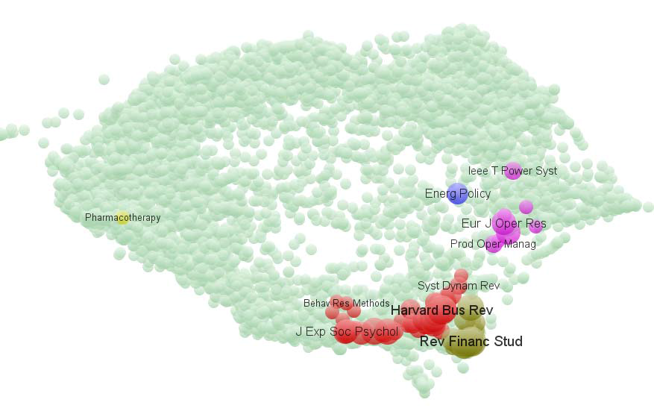
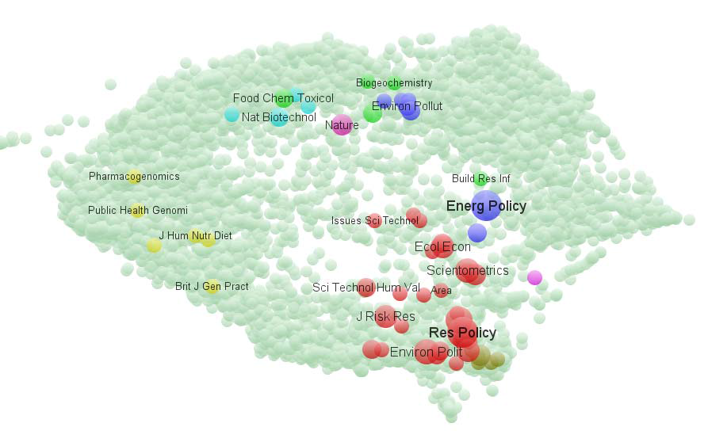
Aids analysis
Overlay maps comparing journal publication portfolios from 2006 to 2010 between the London Business School (on the left) and the Science and Technology Policy Research Unit SPRU at the University of Sussex (on the right).
Notes:
From Leydesdorff and Rafols
Loet Leydesdorff has co-authored with Gaston Heimeriks
Gaston Heimeriks has co-authored with Peter van den Besselaar
Peter van den Besselaar and I have co-authored
Peter, Gaston and I have a bid in to do some joint research next year, so pissibly the three of us will be co-authors
You can imagine drawing a network to show that relationship
But social scientists want more, and that’s what this slide shows
Finding patterns in say tables of data describing publishing choices would be difficult, but here the patterns leap out
There’s an overlap at Energy Policy

Slide 10
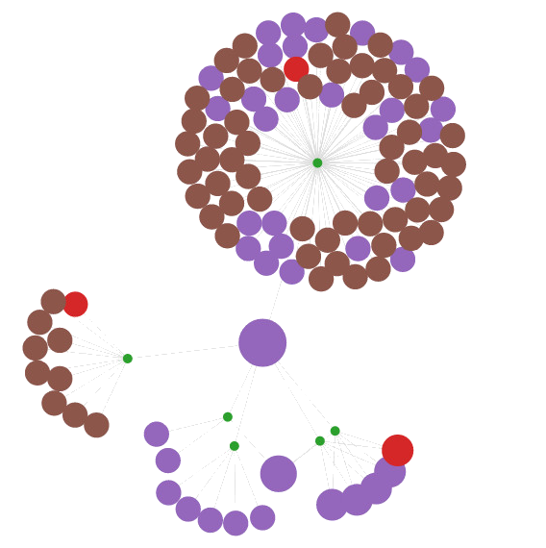
Visualisation example one
A static image showing the interactions between David Shotton and all other authors (purple) with whom he has published an article (green) in the PMC OA subset. The red dots are the journals these articles are in, and the brown are citations.
Notes:
This was a demonstrator and pretty, but so what?
Unless you’re following an author of course.
And remember this image can be made dynamic.

Slide 11
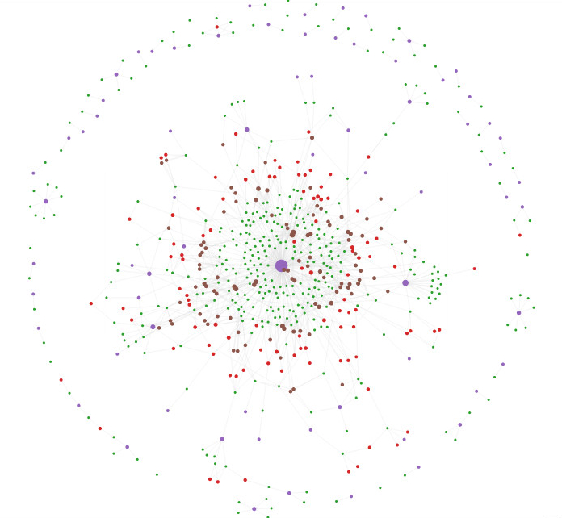
Visualisation example two
This image maps the 383 articles with Malaria as a keyword in the PMC OA, showing all 70 journals in which they are published, with links to the top 100 authors and citations.
Notes:
The original is dynamic, however over the spots to learn more, etc.
Note colours changed from previous demo – purple dots represent journals.
Not clear but spots do vary in size.
And that noticeably bigger purple dot at the centre of the map is the Malaria Journal ☺.
Time to stop and ask audience if this sort of tool might help them search documents?

Slide 12
Possible queries
Simple ones:
papers on malaria
papers by A N Other
papers published in the ABC conference, 2009
Complicated ones
papers by the co-authors of A N Other
papers that are cited by papers in the ABC conference, 2009
Notes:
Simple ones are keyword or field based
Complication only from using two or more search terms in one query
Delibnerately avoiding shoing author and date, which ic probably the most likely search combination
Properly complicated queries when links have to be followed to retrieve the complete results set

Slide 13
An early citation annotation schema
Category Description
Weak Weakness of cited approach
CoCoGM Contrast/Comparison in Goals or Methods (neutral)
CoCoR0 Contrast/Comparison in Results (neutral)
CoCo- Unfavourable Contrast/Comparison (current work is better than cited work)
CoCoXY Contrast between 2 cited methods
PBas Author uses cited work as starting point
PUse Author uses tools/algorithms/data
PModi Author adapts or modifies tools/algorithms/data
PMot This citation is positive about approach or problem addressed
(used to motivate work in current paper)
PSim Author's work and cited work are similar
PSup Author's work and cited work are compatible/provide support
for each other
Neut Neutral description of cited work, or not enough textual evidence for above categories or unlisted citation function
Notes:
From Simone Teufel’s work on document zoning, 2009, not progressed.
Brilliant person with brilliant contributions to biomedicine and biochemistry now.
Looking for arguments in papers and this was proposed annotation schema for citations within documents.

Slide 14
Another, more widely used, annotation scheme
The SWAN 2.0 (Semantic Web Applications in Neuromedicine) ontology
Notes:
As you would expect from its title ;-) SWAN is scientific discourse ontology too! And citations too of course.
Being superseded (2012) by newer ontologies based on FRBR. The Functional Requirements for Bibliographic Record (FRBR) [100] is a general
model, proposed by the International Federation of Library Association (IFLA), International Federation of Library Associations and Institutions
Study Group on the Functional Requirements for Bibliographic Records (2009). Functional Requirements for Bibliographic Records Final Report.
International Federation of Library Associations and Institutions. http://www.ia.org/les/cataloguing/frbr/frbr 2008.pdf (last visited March 12, 2012).

Slide 15
A more recent annotation schema
Notes:
From CiTO annotation box – more comprehensive and more usable, assuming your English is up to the subtleties.

Slide 16
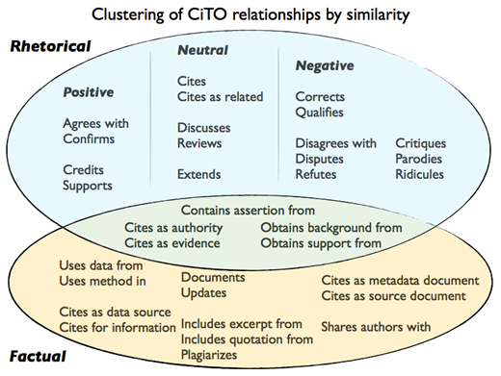
A more recent annotation schema
Notes:
And a summary of the properties from Open Citations blog

Slide 17
entities
type
Citing paper
e.g. Journal article
bibliographic metadata
Title
relationship
Publication date
cito:cites
Bibliographic citation
Unique identifier
provenance
Cited paper
Source of info, e.g. BHL
Notes:
From David’s Leiden presentation to pro-iBiosphere, Feb. ‘13

Slide 18
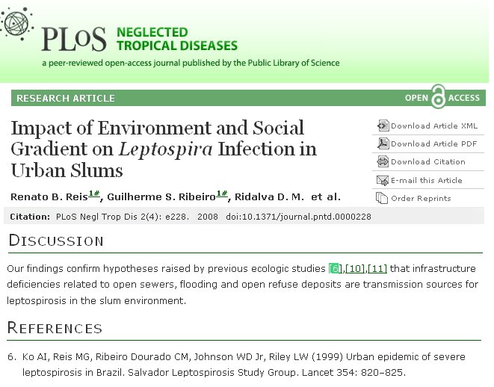
A nomenclature for references and citations
Citing article
c4o:inTextReferencePointer
This is the nomenclature used in SPAR (Semantic Publishing and Referencing) Ontologies
http://purl.org/spar/
that include CiTO, the Citation Typing Ontology
http://purl.org/spar/cito/
c4o:denotes
biro:BibliographicReference
biro:references
cito:cites
Cited article
Notes:
From David’s Leiden presentation to pro-iBiosphere, Feb. ‘13

Slide 19
Possible queries
Simple ones:
give me paper y that cites the paper x
who cites paper x
Complicated ones:
which papers are used in paper x to support the hypothesis that…
who authored papers that reject the hypothesis in paper x
Notes:
The simple queries are possible with Google Scholar etc now
But how many in the audience use the facility to follow a citation trail?
And to branch out on discovering a new author?
The complicated queries are not possible with conventional bibliographic tools; they need the extra innformation and linkage LOD makes feasible.
Are these queries the audience would want to ask though?
Are there any other queries they would to be able to ask?
Don’t need to answer now, will put up e-mail at end and please send me your ideas.

Slide 20
The end…
of my presentation
and of the workshop
Please send your suggestions for new search queries to David.King@open.ac.uk
Thank you for your time
And any final questions?

